Slide 1
Next Gen Digital (NGD) Technical Solution Approach
Feb-April, 2024

Slide 2
Agenda
Current State
Target State
Web Solution Approach
Performance Strategy
Current Gen Vs Next Gen Throttling
Environment and Branching

Slide 3
Current State

Slide 4









North Star Architecture
Current State | Architecture
Human to
Human
Human to
Machine
Machine to
Machine
+ more
Retail
Center
Chat
Online
Apps
IVR
Social
Chat Bot
Smart Assistant
Car
Home/City
Devices
Partners
Engage/
View
Layer
Real Time Intelligence/Delivery
Responsive UI
Access Management
Personalized Cart
eCommerce
Sales & Service Flows
BOT /
Click to call
Content Management
Enterprise Integration SDK
NBX (action, offer communication)
Systems of Engagement
Feedback Loop
Platform Enablers
Experience Services
Contextual Marketing & Campaigns
Search & Indexing
Security, SSO, Session Mgt
Online Catalog
Web Data Cache
Browse
Cart
Acct. Mgt
Bill Mgt
AI Marketplace
Checkout
Payment
NBA/O/C
….
Real Time AI Processes
AI Processor
BPM & Journey Tracking
API Gateway (API Dictionary & Governance)
Streaming
Data
Predictive
Proactive
Channel Experience Mgr
Adaptive
Systems of Insights
Customer Experience Platform
Domain Services
Insights Store
Journey Mgmt (Case/COM)
Profile Services
Ordering
Acct Maint
Bill Estimate
Inventory Mgmt
Tech. Orchestration (SOM)
Customer Intelligence / Data
Catalog Service
Offer Mgmt
Pricing Service
Field / Logistics
Workforce Mgt
Interaction & Segmentation
Robotic Process Automation
Contracts
Fulfillment
Ticketing
3P Integration
Svc Assurance
Customer
Network
Devices
Real time events
BI Insights
Systems of Record
Customer
Profile
Enterprise
Catalog
Charging & Billing
Finance
ERP
Fraud &
Security
Service
Assurance
Network
Data Platform (Oath)

Slide 5
Current State Digital Web Apps Overview
Current State | Web Apps
Sales and Service Flow
Home and Landing Pages
GW / PDP
Lower Funnel
Service
/sales/digital
/sales/next
/sales/nextgen
/sales/nextgen/new
/service
AEM Based Pages
SSR
Next
NextGen
MFE
Service
AEM rendered page
html ,CSS, HTL
React.js + SSR
React.js + CSR
React.js + CSR
React.js + CSR
React.js + CSR
AEM authored content
Server-side data fetch
Client-side data fetch
Client-side data fetch
Client-side data fetch
Client-side data fetch

Slide 6
Current pain points in the ecosystem…
Current State | Pain Points
Design/Experience
Development
Testing
DevOps
Performance
Backend APIs not optimized for various form factors
Multiple web apps with different web architecture leading to poor experience
Inconsistent 3rd party integrations approach across sales and service apps
Data availability challenges during dev cycle
No unit testing on accessibility
Governance around modularity and reusability
API Performance test
Test data dependencies
Integrated Dev Environment availability
Missing Shift left approach for NFRs testing
Performance test – an afterthought
Proactive error monitoring on lower environments
Longer deployments windows on QA environment
API Performance
Impact due to 3rd party integrations
Performance of lower funnel APIs
Performance due to (un-necessary) additional hops
Performance due to design issues
Goal is to synthesize the pain points to ensure NGD fixes what’s not working well, from the get-go
Notes:
Started a lean team last week, with Kick off and onboarding and access requests…
Would drive to integrate copilot/GenAI capabilities during SDLC for core development to pull off the productivity levers…keeping in mind the efforts under Turing from governance standpoint…
Also, would like to bring over the efficiencies by plugging in the framework/accelerators from our in house PS innersource…specially around QE automation, testing and UI frameworks to avoid writing boilerplate code.

Slide 7
NGD Guiding Principles
Jan 2024

Slide 8
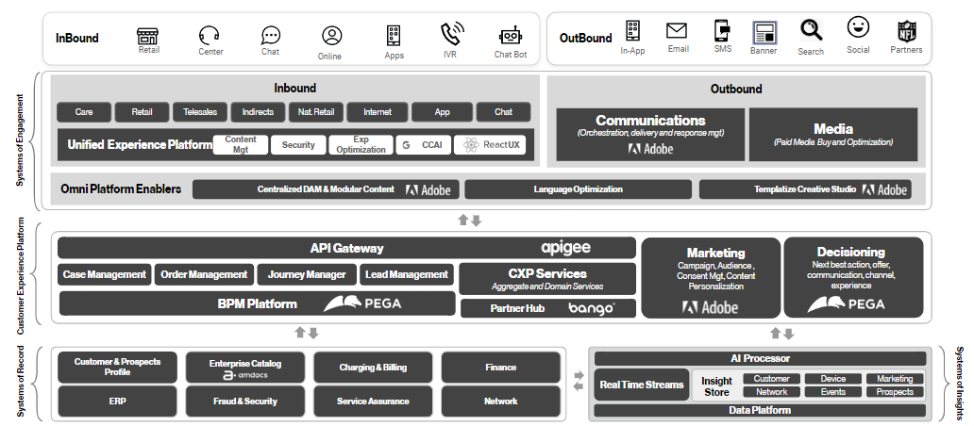
NextGen Digital
NGD Architecture | Building for future
Core Architecture Tenets
Keep it simple, less hops
Trunk Based Code Development
Enforcing architecture guideline (WAST)
NextGen error handling framework
Automated Validation & Governance - SENTRY
Independent track
Restricted Blast Radius
Latency Shame List
Leverage the core tenets of the strong North Star architecture foundation

Slide 9








“Well architected platform” requires strong governance around the following architecture pillars… enabled by a set of “guiding principles” to deliver seamless customer experiences
NGD | Guiding Principles
Agility Configurability Adaptability (evolving needs) Ease of rollout/rollback Faster time to market | Performance Right rendering technique Caching and API Optimizations Monitor, Analyze and Optimize High throughput and low latency | Reliability Design for failure Self Healing Highly Available and Scalable Advanced traceability | Security Protect data in transit and at rest Apply security at all layers Legal compliance
Maintainability Modularity Separation of concerns Reusability Design Patterns | Scalability Loose coupling Minimal dependencies Asynchronous communication | Usability Design for errors Accessibility Seamless & measurable experiences | Automation Shift left Eliminate manual and repetitive work Automated governance Productivity improvements
Notes:
Started a lean team last week, with Kick off and onboarding and access requests…
Would drive to integrate copilot/GenAI capabilities during SDLC for core development to pull off the productivity levers…keeping in mind the efforts under Turing from governance standpoint…
Also, would like to bring over the efficiencies by plugging in the framework/accelerators from our in house PS innersource…specially around QE automation, testing and UI frameworks to avoid writing boilerplate code.

Slide 10
And with that comes the best practices… across the entire development lifecycle…
NGD | Guiding Principles
Architecture
Rendering Approach, Web Frameworks
Application Boundaries , Code Structure
Branching , Environment (Dev, QA, PERF)
Development
Routing / State Mgt / Caching Strategy
Config Management/ Feature flags
Error handling
Instrumentation - Logging / Monitoring
Common Library , VDS Integration
Tagging
Performance Budgets, Monitoring and Optimization
Integrations (incl NBx, Search, 3rd party tools, Analytics, SEO etc)
Testing
Unit testing
Quality Engineering
Load Testing
NFRs
Accessibility AA compliance- Tools & CI/CD
Security Tools & CI/CD
DevOps/Automation
Deployment (throttling, rollout and rollback)
Development Guidelines
Notes:
Started a lean team last week, with Kick off and onboarding and access requests…
Would drive to integrate copilot/GenAI capabilities during SDLC for core development to pull off the productivity levers…keeping in mind the efforts under Turing from governance standpoint…
Also, would like to bring over the efficiencies by plugging in the framework/accelerators from our in house PS innersource…specially around QE automation, testing and UI frameworks to avoid writing boilerplate code.

Slide 11
Target State

Slide 12
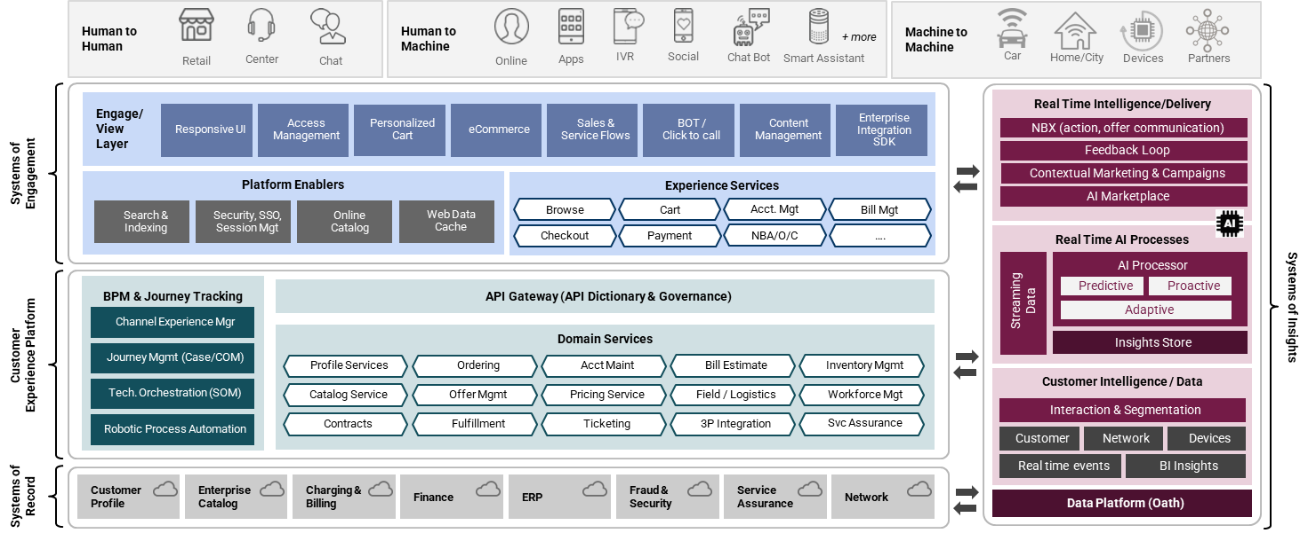
Next Gen Digital Architecture – Directional Target State
NGD | Target State | Overview
Leverage the strong North star architecture foundation and expand to support the next generation capabilities informed by the guiding principles…
Frontend layer (UI / SOE) | New frontend implementation on top of NSA
New frontend app for Next Gen Digital leveraging capabilities & frameworks that’s working well currently
Backend layer (CXP / CJCM / SOI / SOR) | Focused changes on existing backend layers to support enhanced capabilities
Integration
Observability / Traceability
Configurability
Service Layer
Personalization
Authentication
Notes:
Started a lean team last week, with Kick off and onboarding and access requests…
Would drive to integrate copilot/GenAI capabilities during SDLC for core development to pull off the productivity levers…keeping in mind the efforts under Turing from governance standpoint…
Also, would like to bring over the efficiencies by plugging in the framework/accelerators from our in house PS innersource…specially around QE automation, testing and UI frameworks to avoid writing boilerplate code.

Slide 13
Potential Impacted Platform Layers
NGD | Target State | Impacted Layers
Platform Layer | Implication
SOE | New NGD WebApp Update/New SOE services to be exposed for NGD
CXP Aggregate | Update/New orchestrated APIs for NGD
CXP Domain | Changes anticipated to support the new requirement
CJCM | Changes anticipated for journey orchestration based on NGD journeys
PDM(NBX) | New/Update personalization APIs to be exposed for NGD (Learn + Trx pages)
AEM | Template/ Component/ Layout / Content needed for NGD . Target and Personalization related changes.
NativeApp (iOS/Android) | Corresponding App changes for iOS/Android (keeping web views architecture)
Elastic/Fusion | Minimal Impact assumed, if any for newer data attributes or apis
SOR, SOI (AI&D), OpenIG | Changes anticipated to support the new requirement. Changes owned by respective teams.

Slide 14
Web Framework

Slide 15
Why is a framework required ?
Web Framework
Creating a performant web application warrants a framework that’s opinionated and provides additional capabilities around server rendering, routing, builds and configurations for the targeted future state.
Concerns to be addressed | How framework solves for it?
Initial response Initial HTML rendering before JS is downloaded and executed | Multiple initial rendering strategies to improve SEO and faster initial page load. (React Server components, static site generation, server-side rendering)
Routing Leverage the configuration to create faster page transitions | Out of the box, file-based routing in place to create faster SPA experiences
Bundle optimization Sending minimal code required to display the page | OOTB Configuration for automatic JavaScript bundle chunking and optimization
Configuration Setting configuration for governance (code lint, testing) | Various configuration options for setting up developer environment.
Notes:
React (JavaScript library) runs in the browser to generate interactive HTML elements from JavaScript code.
To create a performant web applications, there are core concerns outside of React which must be addressed, which is where Next.js provides an approach to all those aspects…

Slide 16
Framework selection criteria
Web Framework | Selection Criteria
Core criteria
Problems to solve in current state
Enterprise Level
Popularity
Community Support
Maturity
Features Richness
Performance
Advanced rendering and routing capabilities
Ease of build and configurations
Notes:
React (JavaScript library) runs in the browser to generate interactive HTML elements from JavaScript code.
To create a performant web applications, there are core concerns outside of React which must be addressed, which is where Next.js provides an approach to all those aspects…

Slide 17






JavaScript libraries & frameworks evaluated
React 16+
Currently the widest adopted framework. JavaScript based library with virtual DOM, One-way data binding ( parent -> child) Introduces React Server Components Includes state management & JSX Large community support
Angular 13+
Typescript based framework that uses real browser DOM, and Two-way data binding Good for large scale applications Not gaining popularity recently compared to competitors
Svelte 3+
High performance JavaScript library with no virtual DOM required. Less adoption and community support due to complexity Build time processing resulting in excellent user experience. Lack of market talent
Vue 2+
Popular JavaScript framework that uses virtual DOM and component-based architecture. Uses traditional HTML for templating Can generate light-weight apps
Remix
Web framework for modern React application Focusses on user interface and web standards to deliver a fast, slick, and resilient user experience No support for server components
Next
Enterprise grade framework for modern React web apps Purpose built for performance, efficiency and developer experience Leverages the power of React

Slide 18





Next.JS vs Gatsby
Criteria | Next.js | Gatsby
Enterprise Level | Enterprise grade framework for building modern React web applications Adoption by big brands including Ecommerce industry - Source | It emerged as Static Site Generator enterprise solution for React. Has added capabilities for Server-Side Rendering.
Popularity / Community | Market Leader - Steep rise in popularity - 1200% rise in 3 years in npm trends data , 6.3 million weekly downloads 13th most popular repo on Github, 118k stars | Popularity is stagnant in 3 years in npm trends data . 327K weekly downloads , 55k stars on github.
Maturity | Currently on version 14, hardened over 13 years of launch. Developed by Vercel company, other products offerings includes Frontend Cloud | Currently on version 5, launched 9 years back. Owned by Netlify.
Features Richness | New Features - Leads in offering new features with focus on improving dynamic pages rendering. First to give stable release for React server component , HTML Streaming . Rendering Options – Static Site Generation , Server-Side Rendering (SSR), Streaming Support. Routing – Provides advance routing options through file System itself Data fetching & Caching – OOB data fetching on server side using fetch api. Provides in built caching for pages and api data on server with capability for revalidation, has route html caching on browser. | New Features – Adding React server component support but currently it's in Beta. Rendering Options – Static Site Generation , Deferred Static Generation (DSG) , Server-Side Rendering (SSR). Routing- Provides basic routing based on File system. For advance routing need to use Gatsby Node api. Data fetching & Caching – Needs graphQL plugin to fetch data for build time and server side. Page caching via Gatsby Cloud Hosting
Optimizations | Has Focus on built In optimizations , OOB optimizations for lighter client JS bundles with server components. Prefetching new page bundles in background before click via <Link /> component OOB components with inbuilt optimizations like Image, Font, Script Few experimental feature like Partial Prerendering( i.e Caching partial page with Streaming) | Has Image component for lazy loading.
Licensing | MIT | MIT

Slide 19
Web Frameworks Comparison
Web Framework | Comparison
 | Current State(React) | Next.js https://nextjs.org/ | Remix - https://remix.run/
Focus | Build different business journeys using combination of CSR/SSR rendering. Using React app with Express middleware. | Enterprise grade framework for building modern React web applications Build modern web applications with the power of React components. Created for performance, efficiency and developer experience. | Remix is web framework for modern React application. Focus on the user interface and web standards to deliver a fast, slick, and resilient user experience.
Routing | Additional library needed to setup route-based navigation. Server routing handled via custom configuration in Express middleware. | Built-in routing with advance nested capabilities | Built-in routing capability
Rendering | Supports SSR and CSR . SSR handling done via custom code. | Server Components and HTML Streaming SSR(server-side rendering) (eg: landing, pdp’s) CSR(client- side rendering) | No support for server component SWR ( Stale while revalidate) + SSR CSR
Static site generation(SSG) | No support for SSG OOTB. | Supports page generation at build time. Improves page performance and SEO. Example- FAQ page | No support for SSG OOTB.
Incremental Static Regeneration (ISR) | No support for ISR. | Supports TTL based or on-demand regeneration of page. Eg: Regenerating a GW page when there is a change in content from Aem or change in catalog data. | No support for ISR.
Styling Support | Needs to be handled | Built-in support for CSS Modules , Tailwind CSS , Sass, CSS-in-JS libraries | Built-in support for CSS Modules , Tailwind CSS , PostCSS, CSS-in-JS libraries

Slide 20
Web Frameworks Comparison – Cont.
Web Framework | Comparison
 | Current State(React) | Next.js https://nextjs.org/ | Remix - https://remix.run/
Built in Optimization | No built in support. | next/Image loads image only when its visible , does automatically image resizing based on device support. Prevent layout shift automatically when images are loading. In built option to show placeholder. | No such built-in support.
Caching | No built-in support. | Provided Server-side caching with revalidation– Data Cache , Full Page Cache Provides client-side Router Cache for RSC payload Prefetch - Ability to prefetch new page bundles on client in background before visiting that page | Has <Link /> component with prefetch.
Custom Errors | Not built-in, custom handling required. | Allows custom 404 and 500 error code experience for every route segment. | Support 404 error code when url does not match routing
Single Page (SPA) | React-router library used to support SPA. | Supports SPA OOTB | Supports SPA OOTB
Bundle Performance Optimization | Additional setup needed with bundlers like webpack to split code into chunks | Automatic code splitting by route. Built in Bundle analyzer. | Automatic code splitting by route.
Partial Prerendering (experimental) | No built-in support. | Allows static portions of a route to be prerendered and served from cache with dynamic parts streamed in. | No such built-in support.

Slide 21
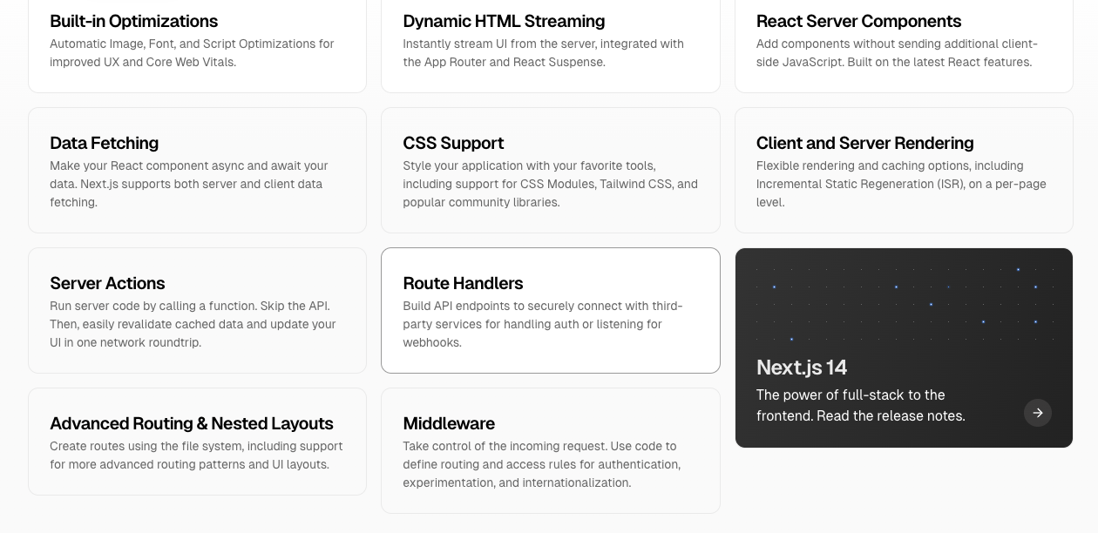
Recommended Framework : Next.js
Key Decision Point | Web Framework
Big brands leverage enterprise grade Next.js framework for building modern web applications

Slide 22
Key Advantages of App Router
App router is the Next.js default option. The legacy Pages router in Next.js will no longer receive updates, so to continue to receive meaningful framework updates, we need to use App Router.
The App router is the only production stable framework providing support for React Server Components. We can’t use them in production today without Next.js.
With RSC, App Router brings the ability to chose where React component code is rendered, which is one of only a few ways to reduce JavaScript execution time on the client.
With App router server rendering, we have a way to lower bundle size on components that can be rendered server side.
App Router provides many updates to the file-based router and new features which will improve our code organization and management.

Slide 23
Addtl. Details on File Based Router updates
The Next.js App Router brings many improvements to the File-based router implementation:
Shared Layouts: App router solves a fundamental issue of the Next.Js pages router, which was how to distribute layout across routes.
Parallel routes / Intercepting routes: Parallel Routes allows you to simultaneously or conditionally render one or more pages within the same layout. They are useful for highly dynamic sections of an app, such as dashboards and feeds on social sites.
Route groups: Route groups enables improved code organization within the router folder structure.
Loading routes: Ability to show instant loading reaction while route segments are rendered.
Error routes: Gracefully handle unexpected runtime errors within nested routes.

Slide 24
Next.js Rendering Strategies

Slide 25
Next.js Rendering Strategies using App Router
Web Framework | Next.js | Rendering Strategies
Client Components
Server Components
Client Components allow you to write interactive UI that can be rendered on the client at request time.
In Next.js, client rendering is opt-in, meaning you must explicitly decide what components React should render on the client.
Key Benefits:
Client Components have access to browser APIs
Client Components can use state, effects, and event listeners
React Server Components allow you to write UI that can be rendered and optionally cached on the server
There are three different server rendering strategies:
Static Rendering
Dynamic Rendering
Streaming
Key benefits:
Client does not have to download, parse and execute any JavaScript for Server Components (Faster FCP)
Supports caching on server

Slide 26

Next.js Server Rendering Approach
Web Framework | Next.js | Server Rendering Strategies
Next.js Server Rendering Strategies
Server Side
Client Side
The HTML is used to immediately show a fast non-interactive page
No bundle is required for server rendered components therefore JS Bundle represents only client rendered components.
The React Server Components Payload is used to reconcile the Client and Server Component trees, and update the DOM.
The JavaScript instructions are used to hydrate Client Components and make the application interactive.
Static Rendering
Next Build
Works well for pages that is not personalized to the user E.g. support pages, static PDP
Revalidation
Dynamic Rendering
On Request
Fetch
Generate HTML
Useful when a page has data that is personalized to the user. E.g. PDP, cart, personalized GW
Streaming
On Request
Useful for UI components that depends on slower data fetches that would block rendering. E.g. accessory recommendations in cart

Slide 27
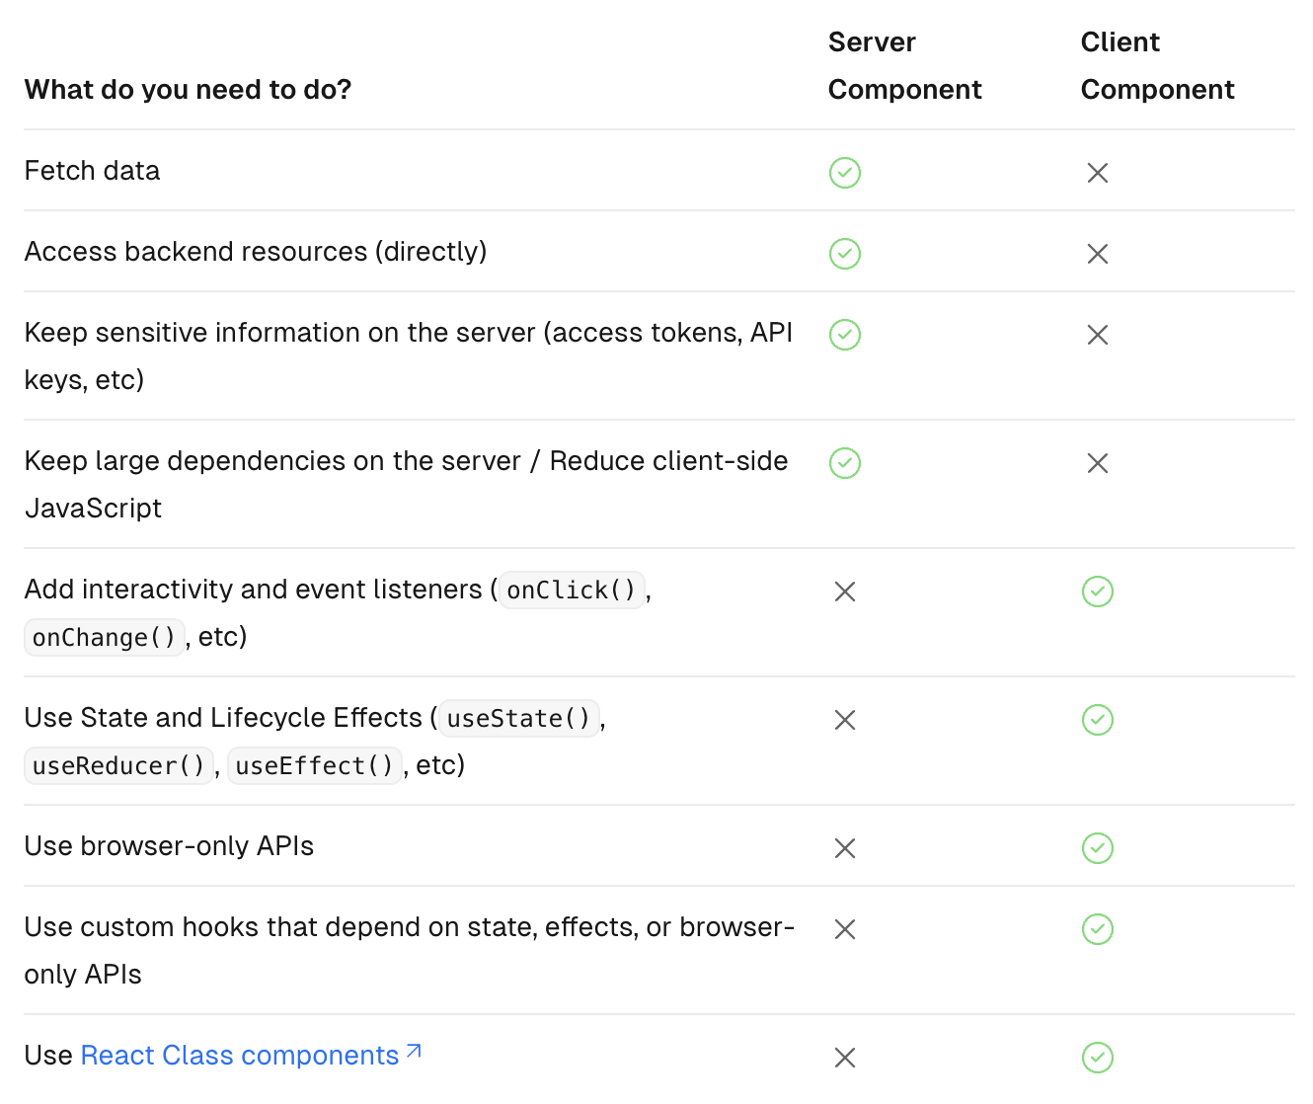
When to use Server and Client Components
Web Framework | Next.js | Composition Pattern
Sharing data between components Fetch on server and share through React cache on client
Keeping Server-only Code out of the Client Environments
Use server directive can keep server code from rendering on the client accidentally.
Moving Client Components Down the Tree
Keep bundle size down by moving interactive components down the component tree

Slide 28
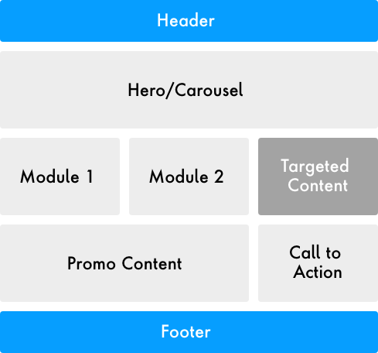
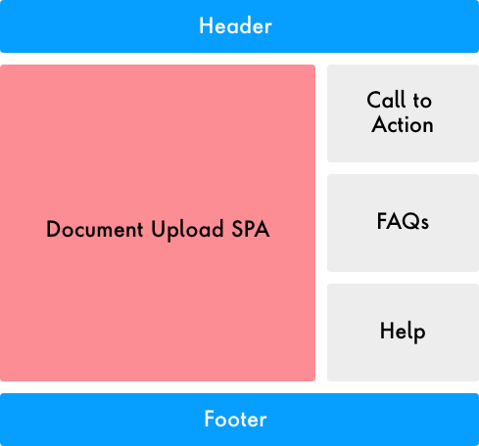
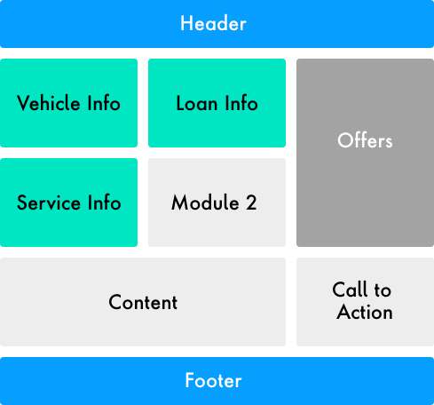
Page Patterns to be considered for Rendering Approach
Web Framework | Page Patterns
1. Content Driven AEM Pages
2. Dynamic Application Pages
e.g.: Marketing page content managed in AEM and published
e.g.: Pages like GW,PDP that can be served from cache but needs to account for personalized dynamic content
e.g.: pages that gets completely dynamic in nature based on customer data
Device Info
Device Detail

Slide 29
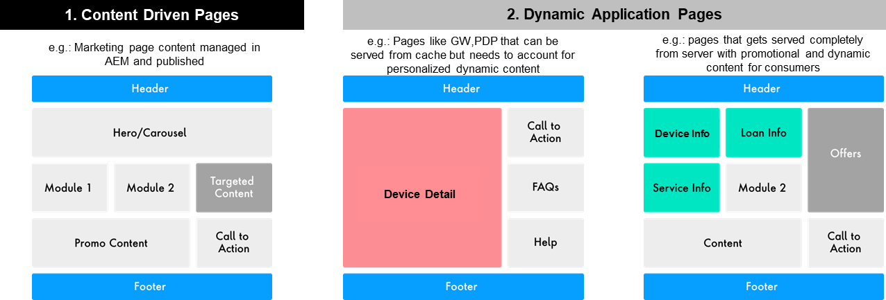
Content Driven AEM Pages

Slide 30
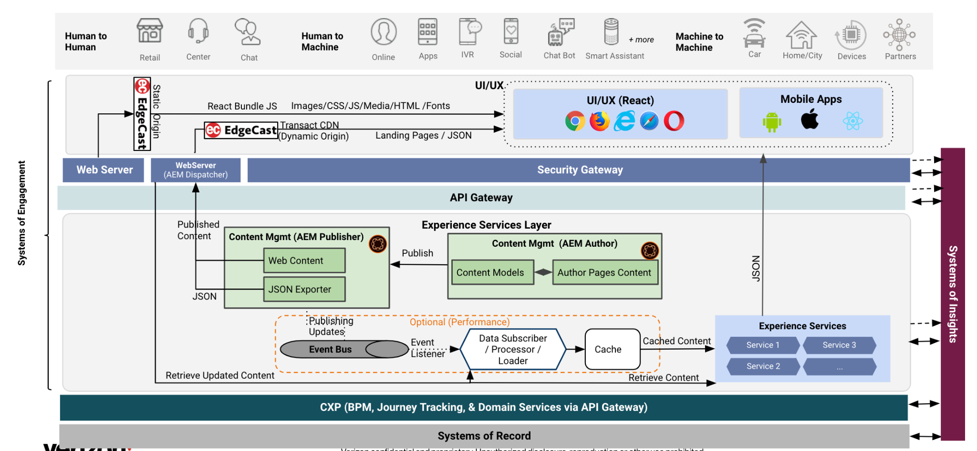
AEM Pages Rendering Strategy
Key Decision Point | Rendering Strategy | Content Driven AEM Pages
Analyzed potential architectural choices for content driven AEM pages with HTL vs Next.js based rendering options.
Criteria | Option 1 - AEM rendered pages (current) | Option 2 - Next.js rendered page
Cacheable Page with Personalization | Traditional AEM implementation with HTL. HTML generated on server side, cached and served via CDN. Personalization would be client side | HTML rendered by React/Next.js via SSR, cached and served via CDN. Personalization would be client side.
Implementation complexity | Low | High
Performance efficiency | High | Medium
Implementation effort | Low | High
Current state approach of AEM with HTL is preferred. With AEM rendering the page and components, making them performant and efficient getting served from the cache.​

Slide 31
Dynamic Application Pages Rendering Strategies

Slide 32
Next.js Rendering Patterns for Application Pages
Next.js | Rendering Strategy | Application Pages
Dynamic application pages can be rendered leveraging various rendering patterns to drive efficiencies and page performance.
Server Rendering
Server + Client Rendering
Client Rendering
Header
Title | Interactive Component
Image
Content
Content
Content
Footer
Header
Title | Interactive Component
Image
User Specific Content
Content
Slow fetch Content
Footer
Header
Title | Interactive Component
Image
User Specific Content
Content
Client side rendered
Footer
Header
Title | Interactive Component
Image
User Specific Content
Content
Content
Footer
Pattern 1
For Static Pages which can be generated at build and Cached
Pattern 2
For Non-Cacheable Personalized / Dynamic Page
Pattern 3
For Cacheable Pages with Personalized / Dynamic Page
Pattern 4
Server Component – Static Rendering
Client Component
CSR Client Side Rendering
Server Component – Dynamic Rendering
Server Component – Streaming
Base Template

Slide 33
Pattern 1 : For Static Pages which can be generated at build and Cached [Server Rendering]
Rendering Strategy | Application Pages | Pattern 1
Header
Title | Interactive Component
Image
Content
Content
Content
Footer
CDN
VZ Yellow Zone
VZ Green Zone
Request Page
Cache HIT
No
OpenIG/Apigee
Node.js
GNAV Fetch
AEM
Browser
Data Fetch
Yes
SOE
Render
Set Cache
Return response
HTML + RSC Payload
Return response
Use Case: Ideal for static pages (non-aem) like T&C without personalized content
Rendering:
All components are Server components. For non-interactive components, React rendering occurs on server.
Caching: Full page HTML + RSC Payload cached at CDN + Data fetching can be cached in memory
Advantages:
HTML + Payload can be generated at build time, or on-demand later.
Should improve performance for slower devices and connections
Notes:
1. Response is used to immediately show a fast non-interactive page
3.The React Server Components Payload is used to reconcile the Client and Server Component trees, and update the DOM.
4.The JavaScript instructions are used to hydrate Client Components and make the application interactive

Slide 34
Pattern 2: For Non-Cacheable Personalized / Dynamic Page [Server Rendering]
Rendering Strategy | Application Pages | Pattern 2
Header
 | Interactive Component
User Specific Content
Content
Slow fetch Content
Footer
Yellow Zone
Green Zone
Request Page
OpenIG/Apigee
Node.js
GNAV Fetch
AEM
Browser
Data Fetch
SOE
NBX
Render
Return response
HTML + RSC Payload
Use Case: Ideal lower funnel and Service pages with personalized content. Suitable for GW + PDP traffic when deployed to Edg.io.
Rendering:
The server will make personalized requests and render components on-demand. All components are Server components.
For non-interactive components, React rendering occurs on server.
For slow fetch content Server response can be streamed and rendered on the client as it becomes available.
Caching: CDN cache not available for personalized requests. Data fetching can be cached in memory. (Next.js cache can be In memory or shared cache like Redis)
Advantages:
Rendering at the on the server, at the Edge, can generate high performance personalized responses.
Should improve performance for slower devices and connections

Slide 35
Pattern 3 : For Cacheable Pages with Personalized / Dynamic Page [Server + Client Rendering]
Rendering Strategy | Application Pages | Pattern 3
Header
Title | Interactive Component
Image
User Specific Content
Content
Client side rendered
Footer
CDN
Yellow Zone
Green Zone
Cache HIT
FEATURE_FLAGS
Request Page
No
OpenIG/Apigee
Node.js / Next.js
GNAV Fetch
AEM
Yes
Data Fetch
Browser
SOE
Return response
Render
Set Cache
Return response
HTML + RSC Payload
Client-Side Fetch
OpenIG/Apigee
NBX
Use Case: Can be used for pages with personalized content. Places the obligation to fetch and render personalized content on the client.
Rendering:
The client will make personalized requests and render components in the browser. Some components are Server components. For non-interactive components, React rendering occurs on server.
Caching: CDN available for server components. Server data fetching can be cached in memory. Personalized fetch cached in browser. (Next.js cache can be In memory or shared like Redis)
Advantages:
Can reduce the burden/traffic on the server by not rendering personalized components on server side.
Don’t need to scale infrastructure more as pages are cached on CDN

Slide 36
Pattern 4 : For Dynamic Pages with server side auth api requests [Server + Client Rendering]
Rendering Strategy | Application Pages | Pattern 3
Header
Title | Interactive Component
Image
User Specific Content
Content
Client side rendered
Footer
CDN
Yellow Zone
Green Zone
/auth
non
cache
/auth — /
Request Page
No
Apigee
Node.js / Next.js
GNAV Fetch
OpenIG
AEM
Data Fetch
sso_jwt (/auth)
SOE
Browser
SSO_JWT
Render
Return response
SOE
HTML + RSC Payload
Client-Side Fetch
OpenIG/Apigee
NBX
Use Case: SSO_JWT to be dropped for loggedIn customer. Currently IG is only pass through for NGD
Rendering: Request comes from browser passes through IG, IG looks for the auth cookies and drop the sso_jwt headers,
Next.js will look for sso_jwt in the server side and initiate the soe/auth calls from greenzone, passes required headers/cookies in the request to the SOE APIs
Caching: CDN will act as a pass through layer, this will not cache the pages for authenticated users.
Advantages:
Can be utilized with streaming different components that depends on different APIs and calls can be made directly on the server side, which reduces the CDN/IG/APIGEE load.

Slide 37
Next.js Rendering Directional Approach
Rendering Strategy | Application Pages | Comparison
Strategy | Pattern | Page Components | Can be cached in CDN? | Full Route Cache | Data Cache | Router Cache | Pros | Cons | Ideal Use cases
Server Rendering | 1 | All components must be static server components | Yes | Yes | Yes | Yes | Can be cached in CDN Better performance and SEO Lower bundle size Less JS render on client Works better with slow connection and slower client devices Can generate during build | No personalization | Static Landing pages (non aem)
 | 2 | Server components + Streaming | No | No | Yes | Yes | Slower data fetches can be streamed later without blocking initial page Lower bundle size Less JS render on client Works better with slow connection and slower client devices | Adequate server infrastructure required to run Next.js Need to scale infra based on traffic | Lower Funnel and Service Pages GW, PDP (with edg.io)
Server+ Client Rendering | 3 | Server Component + CSR | Yes | Yes | Yes | Yes | Lower server cost compared to 2.1 Page can be cached in CDN | CSR increases bundle size and JS render on client compared to 2.1 Could have impact on SEO for CSR sections on the page. | GW, PDP
Client Rendering | 4 | No server + CSR | Yes | No | No | Yes | No Node server cost Can generate during build | Entire React app rendered on client. Blocking script download and execution | Lower Funnel and Service Pages

Slide 38
Web App Structure

Slide 39
Micro Frontends(MFE) – key decision points
Web App Structure | MFE | Key Decision Points
MFE Boundary / Division Patterns
Identify the Micro-Frontend boundaries
Horizontal Split | Vertical Split
MFE Repository Strategy
Mono Repo | Poly Repo
Identify the right approach to package in repositories
MFE Solution
Module Federation | Multizone
Define bundle and code sharing strategy
Notes:
Benefits
Manageability & Scaling - Allows breaking large application into smaller apps
Autonomous teams
Agility for faster time to market- Small teams can work on independent business module and keep releasing to production
Micro apps could use different tech stack
Failure Isolation
Challenges
Managing package dependencies , in most of cases micro apps will be on same stack and need to share dependencies
Hard to maintain absolute isolation – Microapps needs sharing of components and styling among.
Common code governance could become challenging with diff release cycles for micro apps
Splitting could be challenging , wrong split can cause lot of overheads like data inconsistency, poor isolation, hard coupling
Infrastructure cost could increase
CSR with MFE is more prevalent, SSR with MFE is still evolving concept

Slide 40
Micro Frontends – Guiding principles
Web App Structure | MFE | Guiding Principles
Guiding principles when deciding on breaking app in MFEs
Independent deployments, decentralized micro app governance
Aligned with business objectives - Micro app modeled around business domains or features
Focused and parallel development by autonomous team – faster time to market
Clear app boundaries could be defined for one MFE, primarily from user and business perspective.
Loose coupling between micro apps ( ideal scenario is no state sharing )
App is getting larger and harder to manage as single app – high build times, high testing effort.

Slide 41
MFE Division Patterns
Web App Structure | MFE | Division Patterns
Horizontal split
Smaller micro frontends are used to compose a single page.
Vertical split (Recommended)
Micro frontends organized by business domain and features, can consist of multiple pages also in one MFE app.
This must be discussed b/w tech and business teams to define vertical apps boundaries.
Pros
Distinct teams can build and deploy page sections independently.
Reuse is easy due to small size and high modularity
Cons
Teams will focus on smaller pieces of the page, the holistic view of user journey is harder to establish.
More chances of hard coupling like state sharing & inter app communication
Can lead to lot of micro frontends with increased overheads and infra cost.
Gridwall & PDP MFE
Pros
One domain team is responsible for pages within their journey. Can provide holistic vision during development.
Has loose coupling, better aligned with guiding principles.
Component reuse achieved through shared library approach.
Cons
Careful consideration is required to set app boundaries.
Middle Funnel MFE
MFE Boundaries for illustrative purpose only. Actual boundaries to defined based on NGD Design

Slide 42
MFE Repository
Web App Structure | MFE | Repository
Poly Repository
This pattern introduces a separate repository for each frontend application and library.
Mono Repository
A single repository is used for many micro frontends and library. For NGD front-end, this pattern fits well as micro frontends related to digital experience will have same tech stack , dependencies and common library. This repo is only for NGD front-end only and suitable for active development.
We can leverage modern monorepo build systems like Nx.Dev , which have smart features like common library, running tasks for changed micro app , faster dev server with caching.
PR merge owners for specific micro app folder can be defined in Monorepo through Gitlab.
https://docs.gitlab.com/ee/user/project/codeowners/index.html (Tier: Premium, Ultimate)
Pros
Independent build and deploy of micro frontends
Ensures a distinct separation in commit history, pull request merging, and general housekeeping duties.
Cons.
Common components sharing is more cumbersome and requiring additional solutions like published libraries.
Introduces more overhead about dependency version control. Updates must be coordinated across more codebases.
Can lead to poor development experience due to switching repos.
Not easy to enforce consistent code quality and linting.
Pros
Independent build and deploy of micro frontends possible
Easy dependency management
Independent code development with simple code sharing.
Easy to enforce consistent code quality and linting.
Improved developer experience
Cons
More commits in a single repository could lead to increased log history and pull time.
Needs governance when multiple teams working on one Monorepo.
Dependencies (shared)
Common Library (shared)
GW/PDP MFE
Middle Funnel MFE
Lower Funnel MFE
Billing MFE
Notes:
Outline independent build and deploy is possible
Instead of app 1, 2, use real application split, add cleanup, why we are recommending
Clearly call out pros and cons

Slide 43
MFE Solution - In context of Next.js solution
Web App Structure | MFE | Solution
Webpack Module Federation
Based on webpack module federation plugin .
Allow a host or container application to dynamically load code from another application at run time. This allows breaking application in MFEs and able to creating a unified application for end user.
The Module federation collaborators have a plugin for Next.Js, but its not working with Server components/SSR in latest Next.Js.
Multi SPAs Or Multizone (Recommended)
Large application split into Multi SPAs, each SPA application is a vertically split MFE . Multi SPAs/zones are a way of having independent applications that merge on a common domain using gateway/reverse routing configuration.
Within one vertical micro app pages there will be single page experience, navigating to another micro app happens with page refresh.
This aligns with the current multi-SPA architecture, also recommended approach by Next.JS for micro frontends
Pros
Independent build and deployment of individual MFE
Low complexity of configuration required , no host or remotes concept
Loose coupling achieved by no inter-app communication.
Cons
No npm dependencies sharing b/w micro apps.
Dependencies (shared)
Pros
Independent build and deployment of individual MFE
Elegant solution for code reuse concerns. Helps to impose governance through requiring module reuse between apps.
Allows sharing npm dependencies b/w micro apps.
Cons
In some cases when sharing dependencies, tree shaking may not remove all unused code and introduce bloated JS bundle.
Configuration required to define host and remotes, remotes are not resolved at build time, therefore remote issues could manifest during runtime.
Common Library (shared)
GW/PDP MFE
Middle Funnel MFE
Lower Funnel MFE
Billing MFE
MFE Boundaries for illustrative purpose only.
Notes:
More details on tree shaking issue with Module Federation
https://medium.com/@marvusm.mmi/webpack-module-federation-think-twice-before-sharing-a-dependency-18b3b0e352cb
Next.JS example with Multi SPAs Or Multizone - https://solutions-microfrontends.vercel.app/

Slide 44



NGD Web Architecture
Architecture Tenants | Independent Track| Restricted Blast Radius | Trunk Based Development
Develop in Poly Repo | Build and Deploy MFE Independently | Unified App Experience for End User | Architecture Benefits
Code Repositories
Pipeline
Verizon.com
Global Common Repo
(Can be used across channels)
Configurator MFE Repo
Configurator MFE
Build and Deploy Independently
Global Core Frameworks
Common reusable components
Common Libraries
Multiple rendering patterns
a. Static Site Generation
b. Server-side Rendering
c. Client-side Rendering
d. Composite Pattern
Trunk based development
Error Handler
Checkout MFE Repo
Checkout MFE
Logging
… (TBD)
Build
Deploy
…
Tagging
Billing MFE Repo
Billing MFE
Common Libs
Common Components
CPC MFE Repo
CPC MFE
MFE Boundaries for illustrative purpose only
Build Artifacts
Applications
‹#›

Slide 45
NGD MFE Code Sharing considerations
Code sharing is achieved through maintaining re-usable packages and libraries in common repo.
This is equivalent to to how the VDS library components are distributed today.
Shared code written for NGD can fall under two categories,
Framework agnostic components and libraries : (global common remo)
Presentation only components.
Core framework libraries (error handling , logging , tagging etc)
Can be consumed by any apps or other channels with compatible React version.
Consuming apps (eg ;Assisted) will import the shared code using NPM import, and specifying a version in package.json.
Code written with Next.js dependencies : (separate repo - global common next repo)
These are components with Async render methods for Server components or Next specific react components e.g. Link, Script, etc.
Any level of code could still be shared, including presentation,, all the way up to fetching / state management level of components.
Can be consumed by any apps or other channels on compatible Next.js version
Consuming apps (eg ;Assisted) will import the shared code using NPM import, and specifying a version in package.json.
MFEs themselves cannot be imported to another MFE at run time, this is supported only via module federation (current state).
Sharing is a one-way direction, from library to application.

Slide 46
When to use State Management Library?
State Management
Front-end library React has internal component state and context api to manage basic data storing and sharing needs.
Front-end library React has internal component state and context api to manage basic data storing and sharing needs.
Front-end apps need state management libraries when lot of data needs to be shared across different pages in app.
When React api’s are insufficient to handle data operations for your application
If global State is increasing and there are lot of read/write operations to global state.

Slide 47
State Management
Key Decision Point | State Management
Considerations | Recommendation : TanStack Query
Micro app specific State State management could be required for managing state/data within micro apps Each micro apps will have its isolated state , full managed by that micro app only for achieving business functionality. This state only persists for current user session. | Why ? Our approach is to move data fetching to server side and use react internal state or react context api wherever possible. Less boilerplate code to write , no reducers. No separate library or middleware for async data fetching Very good at maintaining asynchronous state(server state) between server and client In built data fetching, caching, revalidation, request deduplication, error retry. @tanstack/react-query gaining lot of traction in community, 2.8 million weekly downloads , 38.6k stars . Launched in 2019 , current version is 5.x TanStack is well maintained, and they are offering lot of other open-source modules as well like Routing, Data Visualization, Charts, Tables.
Global State There could be some data elements like session/feature flags which need to be persisted across micro apps. This will be handled in a separate global state. Only selected data would be stored on it. The state only persists for current user session.

Slide 48
Verizon Design System (VDS) Integration
VDS Library | Integration
To facilitate governance of design, enforcement of best practice, and component reuse, we intend to leverage the VDS component library.
Prerequisite considerations
Alignment on style system for components intended for library
Newly built presentation components with Server rendering in mind
Client components will be a light as possible and held low in the React component tree
Build process
Reusable components can be earmarked for design library during UX review phases. VDS team can be tasked with development support.
One-off components, components with complex integration, frequent iteration can be developed in NGD, and migrated to VDS when re-use becomes necessary.
Notes:
Blueprint app should incorporate all the tools right from the beginning such that we can sort out all the nitty-gritties of integration of tools in SDLC, governance (pre-commit hook v/s PR analysis) and thresholds

Slide 49
Unit Testing
TESTING TYPE | JEST | CYPRESS
Unit Testing | Excellent support | Excellent support
Unit Testing - Server Components | Supported | React Server Components not yet supported. (This is in cypress road map to be address this year)
UI Testing (Styling) | Not supported | Supported OOTB
End-to-End Testing | Not Supported | Supported OOTB
Accessibility Testing | Supported | Excellent support since tests run in actual browser env.
Given React Server Components are not supported by Cypress, it’s not feasible to use this currently for unit testing
Key Decision: Jest with React library would be used for component unit testing
The main advantage of Cypress over Jest for “Component testing” is the ability to perform UI testing.
Writing visual test cases during development is feasible, but doing this for each component is time consuming and error prone. The better option is to integrate a visual comparison tool in CI to do a page level visual comparison against figma / previous deployment
E2E testcases would be covered by QE automation , hence not using cypress would not result in low test coverage for unit testing.
Open Item: What E2E test cases dev team should execute using cypress without duplicating the QE E2E automation test case 4/24

Slide 50
WAST
Tool | Usage | Remarks
WAST | Well Architected Score Tool [WAST] evaluets rules and assigns the scores for below category https://wast.verizon.com/about Application Inner Architecture (Code Quality, Languages, Libraries , Unit Testing) Application Outer Architecture (tracing) Application Integration Architecture (external integration, legacy system integration) Tech Stack (Tools used for API Gateway, Compute, Search, Caching DB, OS) Security Architecture Code smells | The services are already enabled for WAST tool. No further next steps for NGD to enable this. The score needs to be monitored

Slide 51
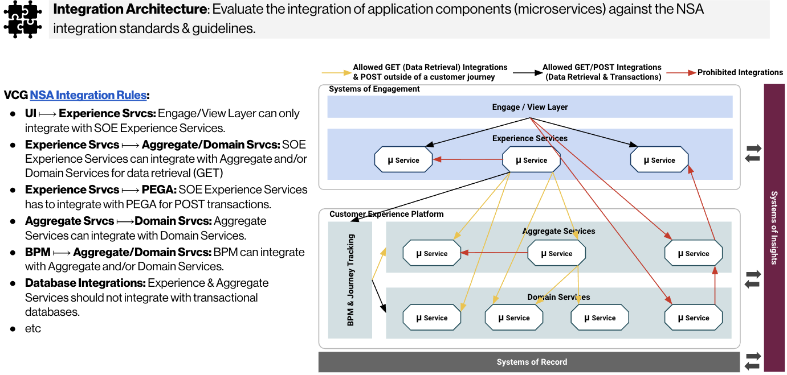
Sentry
The services are already enabled for SENTRY tool. No further next steps for NGD to enable this. The score needs to be monitored

Slide 52
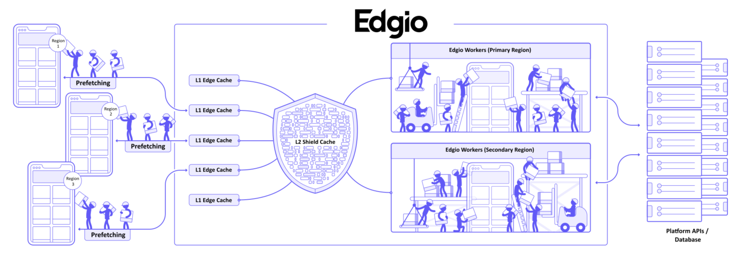
Edg.io Architecture | Serverless Platform
Edgio extends the capabilities of a traditional CDN by providing server-side rendering for web applications as well as caching both your APIs and HTML at the network edge to provide your users with the fastest browsing experience.
Edge Caching (CDN-As-Code ) While most CDNs only cache content on your asset URLs, Edgio caches content on your page URLs using EdgeJS, allowing you to control caching within your application code. | Server side rendering (SSR) via JS workers in multiple regions. Edgio supports all of the most powerful features of Next.js! | Predictive Prefetch Edgio allows you to speed up the user’s browsing experience by prefetching pages and API calls that they are likely to need | Traffic Splitting Traffic splitting can be used for canary deployments, Blue/Green deployments, iterative migration off of a legacy website

Slide 53

Edg.io |Pattern 1 : For Static Pages which can be generated at build and Cached [Server Rendering]
Header
Title | Interactive Component
Image
Content
Content
Content
Footer
VZ Yellow Zone
VZ Green Zone
Request Page
Cache HIT
GNAV Fetch
No
NextJS
4
OpenIG/Apigee
AEM
1
2
3a
5
Browser
Yes
SOE Services
6
Data Fetch
3b
Return
response
Render
8
Set Cache
7
HTML + RSC Payload
9
Return response

Slide 54
Edg.io |Pattern 2 : For Non-Cacheable Personalized / Dynamic Page [Server Rendering]
Header
 | Interactive Component
User Specific Content
Content
Slow fetch Content
Footer
VZ Yellow Zone
VZ Green Zone
Request Page
GNAV Fetch
NextJS
3
OpenIG/Apigee
AEM
1
2
4
Browser
Data Fetch
5
SOE Services
Render
Return response
NBX
6
HTML + RSC Payload
Personalization Fetch

Slide 55
Performance Strategy

Slide 56
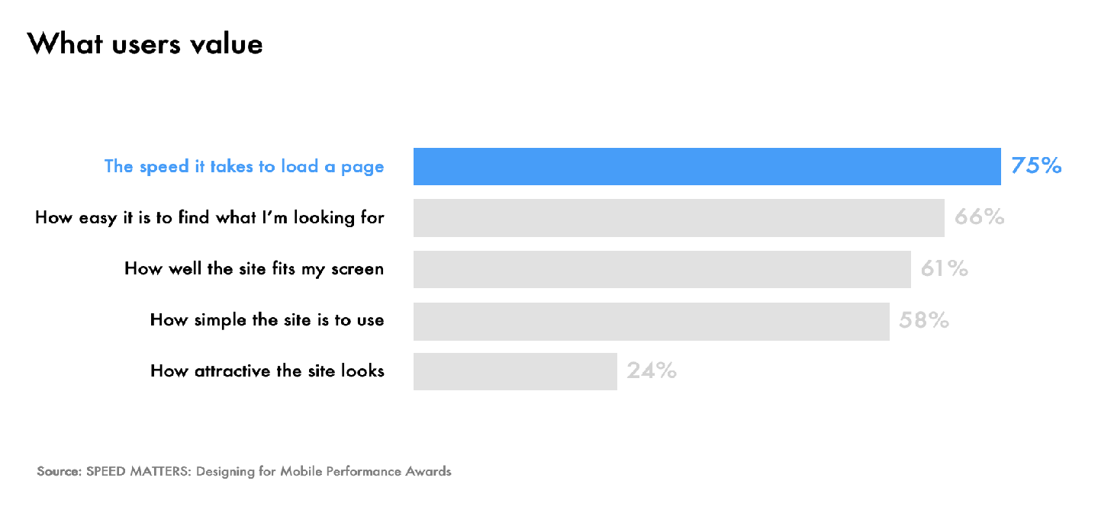
Well known fact as to why “Performance” is the key for any digital experience
Performance Strategy
Web performance is usually talked about as an aspect of user experience, but the fact is, it is the most important element of user experience…

Slide 57
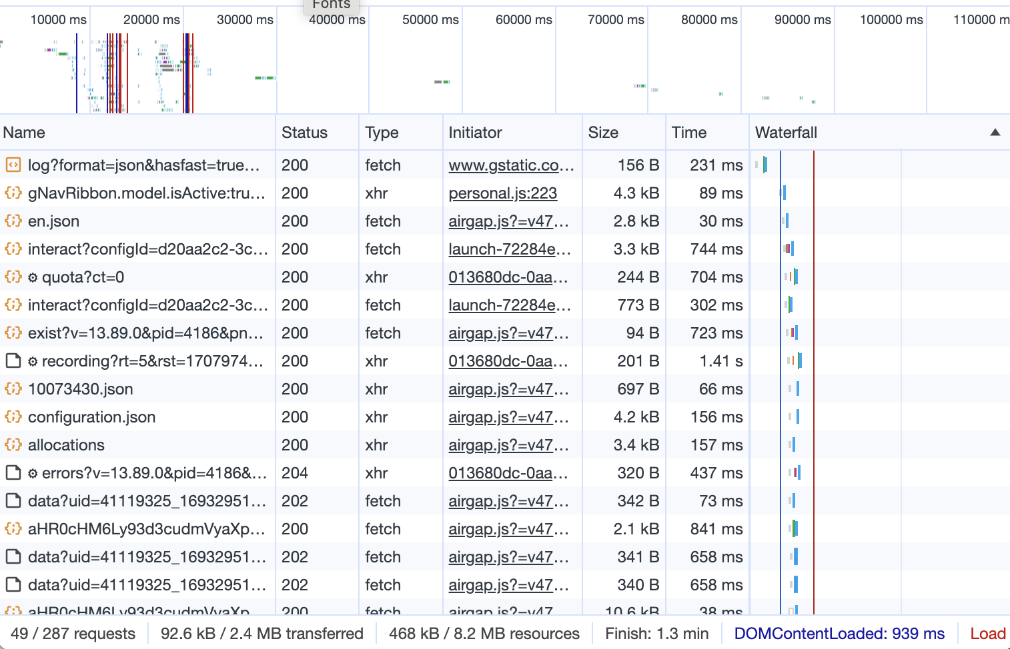
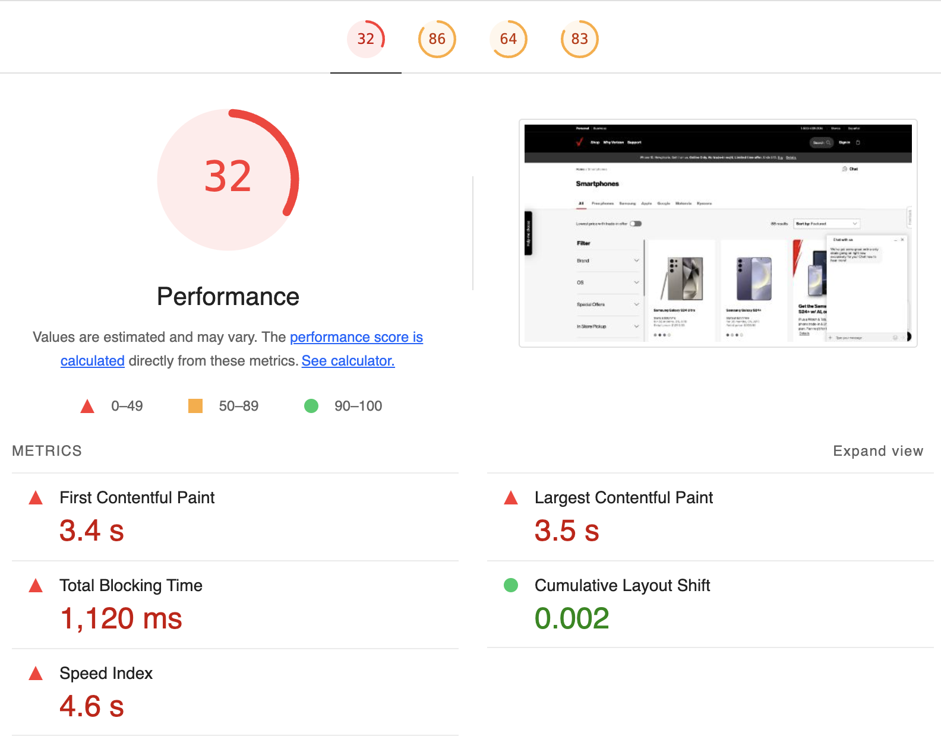
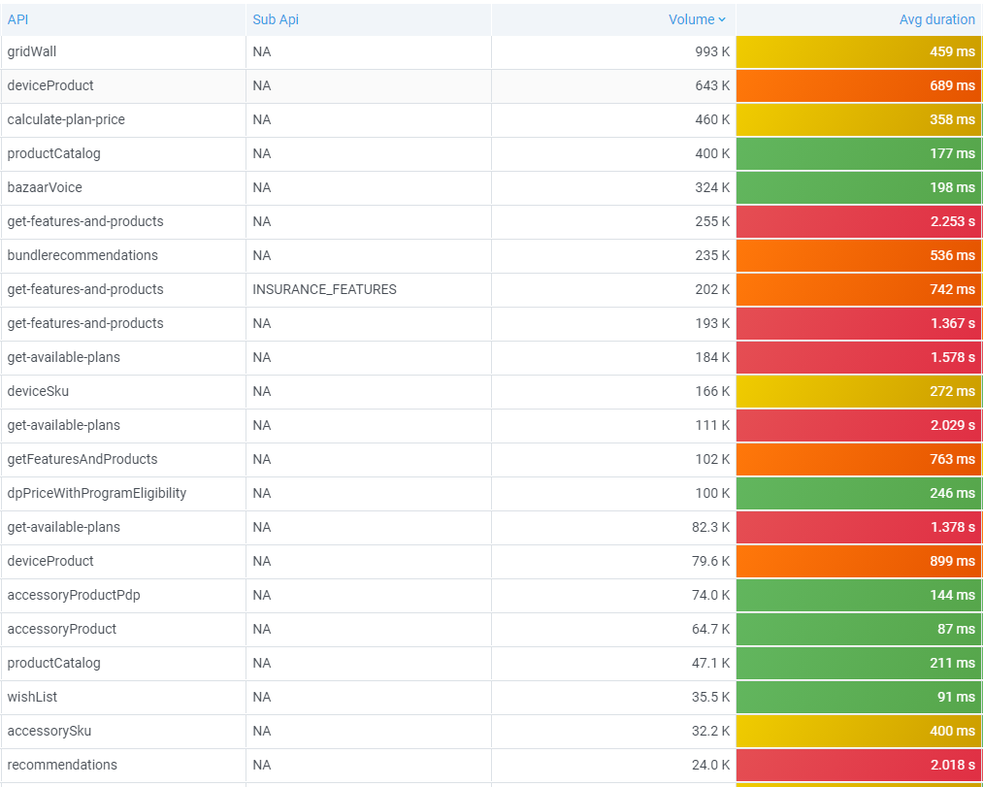
We know performance is a bottleneck across front and backstage…
Performance Strategy | Bottleneck
… hence performance needs to be looked at holistically overall

Slide 58
Performance – Thematic Findings
Performance Strategy | Findings
Customer Lens
Page Rendering Large JS file and JS execution time is impacting key web vitals specifically LCP, speed index Third Party scripts impacting web vitals metrics Multiple domains leveraged for static assets including java scripts (scache-ws.vzw.com) | API / Backend NBX response times on browser is much higher than server side indicating network latency Average API response times for transactional APIs (e,g, add-device) is higher than 1 sec APIs not designed for various form factors | Architecture 6+ hops in current architecture Latency threshold scores are relatively higher
Platform Lens
Performance Monitoring Inconsistent measures of performance across pages Different tools to capture data across mobile and web | Testing Except Iconic, this is an afterthought and is done in Production environment (on request basis) No dedicated performance test environment
Notes:
OPEN ITEM: Feedback from Abhilash: Caching Layers – need to get more details on what are the challenges with various caching layers
Started a lean team last week, with Kick off and onboarding and access requests…
Would drive to integrate copilot/GenAI capabilities during SDLC for core development to pull off the productivity levers…keeping in mind the efforts under Turing from governance standpoint…
Also, would like to bring over the efficiencies by plugging in the framework/accelerators from our in house PS innersource…specially around QE automation, testing and UI frameworks to avoid writing boilerplate code.

Slide 59





We derive performance strategy on already established architectural drivers and guiding principles
Performance Strategy | Overview
Our performance approach will focus on following areas to effectively balance the triad of performance, functionality, and user experience.
OPTIMIZE
DEFINE GOALS & OBJECTIVES
Leverage shift-left practices, foster cross-functional collaboration, and realign on performance goals to continuously optimize system performance
Define collaborative performance engineering goals by aligning KPIs, clarifying business needs, and fostering cross-team communication for optimal outcomes.
01
02
04
03
MONITOR & ANALYZE
DESIGN & DEVELOP
Leverage observability tools to monitor system performance KPIs, and analyze performance metrics collaboratively for proactive issue resolution
Establish best practices, performance-focused tools, and review guidelines to optimize system performance and user experience collaboratively during design and development phase
Notes:
Examples:
Bundle analyzer – builds can be failed based on bundle size thresholds
SLA per API/Component: build failure if component SLA are not met
Data-driven decision making is must in a collaborative environment

Slide 60
Performance Engineering
Performance Strategy | Performance Engineering
Empower teams to proactively address performance concerns from the outset, optimizing system efficiency and user experience for enhanced product quality and stakeholder satisfaction throughout development
Feedback Loop
Grooming
Application Dev
Engage
Continuous Integration
Observe
Act
Tech Design
Perf Dev
 | Backlog Refinement | Development | Integration | Production
Purpose | Define performance goals | Validate components SLA | Validate Performance Goals, Performance Budget , SLO/SLA | Validate Performance Goals, Performance Budget , SLO/SLA
Tasks | Define performance goal for each requirement Define performance budget Define SLO/SLA for each application component (SOE, CXP, SOI etc) | FE/BE Component performance test (eg: Gatling, lighthouse) Develop load test scripts Pre-Commit and PR analysis Gating checks Performance Tuning, Code Review | Synthetic test (site speed, catchpoint) Scaled load , endurance test Performance Tuning | Synthetic test (site speed, catchpoint) Scaled load , endurance test Spike Test Scalability Test
Owner | PO/Business, Architect, SRE | Application and Performance Developer | Performance Testers | Performance Testers
Legends
New tasks in SDLC
Notes:
Key point: Leverage shift-left practices, foster cross-functional collaboration, and realign on performance goals to continuously optimize system performance

Slide 61




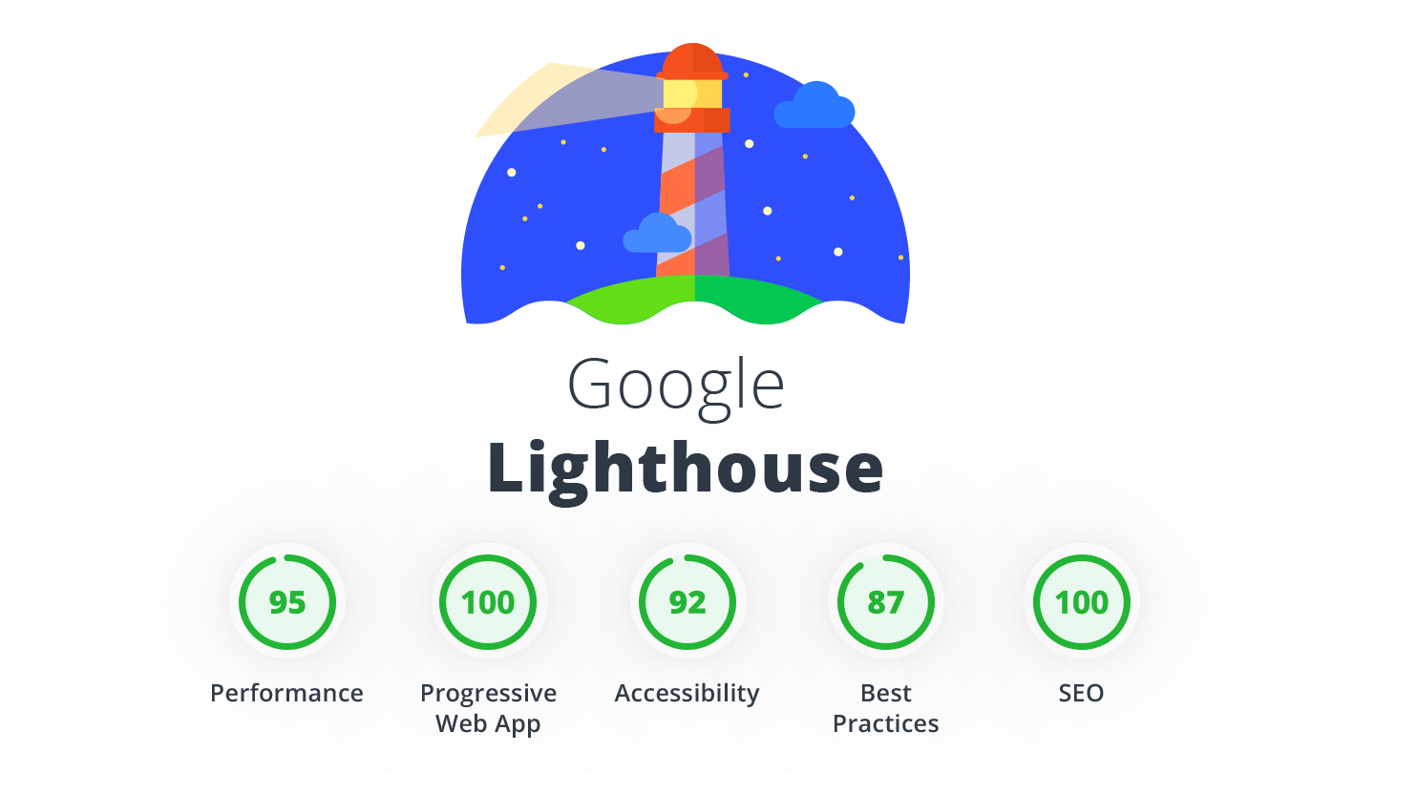








Performance Engineering | Design & develop | Tools in SDLC
Performance Strategy | Tools in SDLC
Performance-focused tool integration in the SDLC enable teams to continuously monitor system performance, identify bottlenecks, and optimize application behavior, thereby ensuring efficient and effective software development processes
Requirements
Development
Integration
Hardening
Production
Dev time
manual checks
Pre-Commit
gating checks
PR analysis
gating checks
CI Build
gating checks
CI Deploy
checks
SIT Deploy
checks
Prod/Canary
checks
Push
code
PR
raised
PR
approved
code compiled
bundle-analyzer
size-limit
size-limit
size-limit
Define Performance Goals, Performance Budget , SLO/SLA
fail merge
if JS size > xxx kb
fail merge
if JS size > xxx kb
fail merge
if JS size > xxx kb
fail deploy based on perf budget
Web
Dev
Import-cost
Product Owner
Architects
SRE
Backend
Dev
fail build
if 90 pct RT > xx ms
fail build
if 90 pct RT > xx ms
fail build
if 90 pct RT > xx ms
Perf scripting & test data prep
Perf
Dev
Legends
New tool introduced in SDLC
Existing tool shift-left's in SDLC
Notes:
Does NR support alerts today?
Backend change and how to check if the performance miss is due to NGD or something else
Tools: what governance can be put up during dev phase itself

Slide 62
Performance Engineering | Design & develop | Performance tools
Performance Strategy | Performance Tools
Performance-focused tool integration in the SDLC enable teams to continuously monitor system performance, identify bottlenecks, and optimize application behavior, thereby ensuring efficient and effective software development processes
Tool | Usage | Performance Validation
@next/bundle-analyzer | Tool for analysing bundle size in Next.js apps, helping developers optimize performance by identifying large dependencies | Manual checks and corrective actions on large dependencies
import-cost | VS Code plugin shows package size impact, informing developers about file size repercussions of adding dependencies | Manual checks and corrective actions on large dependencies
Lighthouse CI | CLI based extension supports evaluation across performance, best practices and other metrices | Automated build failure if page web performance score < xx %
nx-size-limit | This tool helps control JavaScript application sizes, preventing bundle bloat. It sets size limits for bundles, alerting developers if they exceed thresholds, thus optimizing performance | Automated build failure if JS > xx kb
jProfiler | With IDE plugin, this tool can help debug performance issues within the code (Java) | Manual code profiling and performance debugging
Gatling | Gatling allows developers to script and automate performance tests using code which can be integrated seamlessly into CI/CD pipelines for assertions and quality gate | Automated build failure if 90 pct RT > xx ms
SonarQube | Static code analysis tool that helps identifies potential opportunities through code efficiency and tech debt reduction | Manual checks and corrective actions on offending code
sitespeed.io | Tool for website performance testing, analysing and monitoring metrics like speed, accessibility, and user experience | Manual checks and corrective actions on metrics below defined thresholds
Load Runner | Load testing tool used for lower environments
NeoLoad | Load testing tool used for Production environment
NewRelic | Provides application performance monitoring, helping developers understand and optimize app performance, troubleshoot issues, and enhance user experience
Legends
New tool introduced in SDLC
Existing tool shift-left's in SDLC
Notes:
Does NR support alerts today?
Backend change and how to check if the performance miss is due to NGD or something else
Tools: what governance can be put up during dev phase itself

Slide 63
Performance Engineering | Monitor & analyze
Performance Strategy | Monitor & analyze
In the paradigm of performance engineering, prioritize proactive monitoring and analysis using APM-driven metrics with keen focus on optimizing application performance and responsiveness by empowering early detection and resolution of performance bottlenecks
SRE Dashboard
Response Times Metrics
Utilization Metrics
User Experience Metrics
Performance Metrics
Synthetic Monitoring (Web)
Monitoring
Server response time
Network latency
CPU utilization
Memory utilization
Page load times
Web vitals
AJAX
Page Load Time
Historical performance monitoring (ER wise)
Performance monitoring
Availability & reliability monitoring
Journey monitoring
Channel monitoring
Availability monitoring
Reliability monitoring
Comparison across test locations
Error Rate Metrics
Throughput Metrics
Dependency Metrics
Optimization Suggestions
Synthetic Monitoring (App)
Error rate per transaction
HTTP error code (4xx, 5xx)
Exception rate
Transactions per second
Request per minute
Bandwidth usage
External service response time
Dependency utilization
Accessibility
Resource optimization
App speed monitoring
Resource utilization monitoring
Recommendations
Monitor, assess, and report SLOs and SLIs for individual components throughout the journey, not solely focusing on overall page load times
Enforce use of consistent metrics across the organization (e.g. SRE dashboard monitors and reports page load time metrics while sitespeed measures on Web Vitals)
Enable Glassbox onto lower environment for early detection of experience degradation due to performance issues
Notes:
Recommendations:
Incorporate APM instrumentation onto lower environments to enable proactive issue detection and resolution. It empowers teams to identify and address potential issues early in the development cycle, optimizing system performance and user experience iteratively.

Slide 64
Performance Engineering Approach
Architecture Tenants | Latency Shame List
Empower teams to proactively address performance concerns from the outset, optimizing system efficiency and user experience for enhanced product quality and stakeholder satisfaction throughout development
Developer Box | Code Reviews | Code Integration
API performance test case authoring Service virtualization for mocking service dependencies Scaled load tests Code profiling Git hooks | Automated component performance testing and decorating Pull Requests with identified performance issues | Scaled performance tests as part of CI/CD pipelines to fail-early fail-fast Measures and thresholds considered for JavaScript asset size, Page load behaviors and API response times
Shift-left benefits:
Allows component level performance testing by virtualizing key dependencies
Enable teams to detect and address performance issues early in the development lifecycle

Slide 65
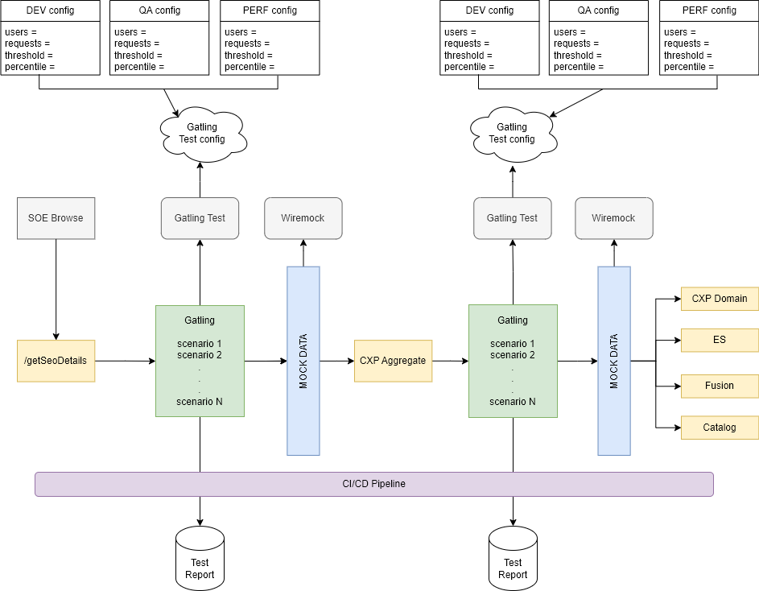
Gatling and Service Virtualization Approach
Architecture Tenants | Latency Shame List
Gatling
an open-source tool, empowers developers with a user-friendly approach to load and performance testing.
Start with core functionality
Modular test design
Data-driven testing
Wiremock
a lightweight mocking framework written in Java, empowers developers to create realistic virtual representations of external services
Mock only necessary services
Define realistic responses
Clear documentation of stubs
Clean up stubs after tests

Slide 66
API Performance Testing | Gatling vs K6
Component performance tests can help identify and mitigate potential performance issues early in the lifecycle. Relevant tools can be integrated in the development process (IDE, build) to accelerate adoption.
MEASURE | GATLING | K6
Scripting language | Java, Scala | JavaScript
Protocols supported | HTTP (REST, GraphQL, SOAP), WebSockets | HTTP (REST, GraphQL, SOAP), WebSockets
Scripting support | Recorder, HAR Converter | Recorder, HAR Converter
Assertions | Response time, Throughput based on Avg, Max, Min, Percentile | Response time, Throughput based on Avg, Max, Min, Percentile
CICD Integration | Supported via Jenkins plugin | Direct command-line execution
Notes on comparison:
Both, Gatling and K6, are equally powerful tool for API performance testing
Considering the NSA components where API performance testing needs to be employed (SOE Experience Services, CXP Aggregate, CXP Domain), they all are Java based applications owned and managed by Java developers
For ease of adoption and simplicity in scripting for Java based developers, it is recommended to leverage Gatling for API performance scripting

Slide 67
Service Virtualization | Wiremock vs Microcks
Mocking framework allows easy integration in already established development processes for quick and seamless adoption. Less resource intensive, can be run on developer box directly without additional tools/softwares and allows configuring mocks with various data profiles (responses, status codes, errors) without relying on availability of actual dependency.
MEASURE | MICROCKS | WIREMOCK
Mock development | GUI, Open API Specs | Code, configuration
Protocols supported | HTTP (REST, GraphQL, SOAP), WebSockets | HTTP (REST, GraphQL, SOAP), WebSockets
Runtime | Needs dedicated infrastructure and config repo to be maintained as separate instance | Runs as in-memory JVM
Governance | Needs central process for managing test data, specs/endpoints per mock applications | Test data management as per the underlying test cases which can be managed by developers
Notes on comparison:
Both Microcks and Wiremock are equally powerful tools for service virtualization
Microcks is more relevant when services are being developed and only have approved API contract to start development with, while WireMock is better suited for mocking existing services and corresponding dependencies
For ease of adoption and simplicity in configuration for Java based developers, it is recommended to leverage Wiremock as it is managed within the same code repo where mock is required

Slide 68
Performance Engineering | Step Forward
Performance Strategy | Step Forward
Key actions and next steps to elevate performance engineering to its next level of effectiveness and integration within development lifecycles.
Theme | Action
Shift-left | Enable CDN on SIT environment(s) to integrate sitespeed.io into the ongoing sprint cycle seamlessly
 | Implement production-like test data management on lower environments to facilitate scaled load testing effectively
 | Establish governance for code quality and performance throughout the Software Development Life Cycle (SDLC) to foster a fail-fast, fail-early culture
Monitoring | API layer SLI/SLO should be captured as part of requirement such that SLI/SLO for each component/layer could be tracked and alerted upon
 | Set up alerts on both Non-Prod and Prod environments for service errors (4xx / 5xx) and service degradation (performance dropping below defined thresholds)
 | Enforce use of consistent metrics across the organization (e.g. SRE dashboard monitors and reports page load time metrics)

Slide 69
Performance Recommendations (AEM)
We analyzed speedcurve report for home page & other browse pages. Following common patterns of performance recommendations came out. Most of these can be fixed on AEM layer.
CATEGORY | RECOMMENDATION | IMPROVES | RESOLUTION | FIX AREAS
ASSET | Add height width to <img> | CLS | Review <img> tag and add height & width parameter | AEM, Frontend
ASSET | Optimize Image disk size to reduce load time. | LCP (Large Contentful Paint) | Reduce/Optimize disk size of image in Scene7 | Scene7
ASSET | Use image size (height & width) respective to site section | Asset Load Time | Review and pass accurate image height & width per site section need. Author correct size in scene7 image URL | AEM, Frontend
CACHING | Increase browser cashing time for js/css. (Current js/css = 1 hr to 10 mins) .Long cache lifetime can speed up repeat visits to your page | Asset Load Time | Review and Update cache time (Cache-Control header) setting for js/css in dispatcher/CDN | AEM,CDN

Slide 70
Performance Environment
Current State
There is no dedicated performance environment
Load test in performed in SIT environment once per ER or on need basis
SIT Environment is non comparable to Production in terms of infrastructure , availability of CDN etc
Fully scaled load test in performed in production
Discussed the feasibility of having a dedicated environment with SRE and PERF Team
This would incur additionall cost and support to maintain a separate environment
Aligned following approach for NGD performance testing cycles
There will not be a dedicated PERF in lower environment
Shift left Process identify the performance issues ahead of time
Continue using SIT for load test in lower environment
Fully scaled load test will be performed in production
Next Step: Setup CDN for all SIT environment. Reached out to SRE on this ETA on approach closure 4/25

Slide 71
Shift-Left Status
Task | What's Covered | Status | Tasks Covered outside of Blueprint
Gatling and Service Virtualization | API level performance test case authoring using Gatling Service virtualization using Wiremock and Microcks Wiremock vs Microcks comparison | Done | Integration with VZ code base VZ CI/CD Setup Grafana Reporting
Import Cost (IDE Plugin) | Setup on dev pipeline to check js import size Developer reference documentation on installation | Done | Define budget for VZ pages
Bundle Analyzer (IDE Plugin) | Setup on dev pipeline to analyze js bundle size Developer reference documentation on installation | Done | Define Budget for VZ Pages
Sitespeed | Integrated quality gate in Deployment phase Single page URL based test Multi-page user journey scripting Page specific assertions configurations Build failures based on configured threshold | Done | Define Budgets Integration with VZ CICD pipeline Reporting
size-limit | Size based unique thresholds by file types (JS, CSS) | Done | Integration with VZ CICD pipeline
Grafana K6 | POC: Front end load test using Grana K6 | Done | Decided not to use since since its in experimental phase
Grafana Faro | Integrated with Blueprint App for RUM | Done | Integration with NGD Buy flow
Axe Core - Accessibility | POC for AXE Core Integrated with pipeline for Accessibility Check | Done | Integration on CICD pipeline

Slide 72
Tools , Frameworks

Slide 73

















Tools | Development Phase
Coding
Dev Testing
Code Quality & NFRs
Git hooks
IDE
Accessibility
Axe core
Web
Developer
Security
Code Quality
Performance
Bundle Analyzer
Commit
Import Cost
Security
IDE
Code Quality
Backend
Developer
Performance
New tool
Notes:
Does NR support alerts today?

Slide 74






Tools | CI/CD Phase
PR Pipeline
CI
CD
Web
Developer
Accessibility
Axe core
Pull Request
Coverage
PR Merge
Backend
Developer
Coverage
New tool
Notes:
Does NR support alerts today?

Slide 75
NGD Environment and Branching

Slide 76


Environment
Code Check-in
Build / Deploy
Dev/DIT
QA/SIT
PERF
Canary
Prod
Dev Environment
In Current state DIT environment is not used effectively for development and is not stable.
Open Item: NGD Usage of DIT.
Load testing environment
In current state Load test in done in SIT or Prod. There is no dedicated load test environment.
Open Item: Dedicated load test environment
Discussion Point:
Frequency of build and deployment to SIT Active / Passive.

Slide 77
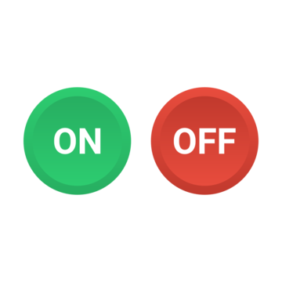
Environment Strategy
Next Gen development environment can either follow a “dedicated” environment approach vs “co-existence”. With initial guidance around leveraging existing release environment with coexistence model.
CurrentGen and NextGen development to co-exist in the same environment during development following release cycle.
NextGen implementation across application layer to be build based on feature flag
Every ER NextGen features will be deployed to production in dark until Go Live/release
R & R+1 environment strategy avoids any wait time wastage due to code freeze or backend SQA environment switches for every release.
NextGen Development and Test |  |  | NextGen Launch
April | May | June
Environment 1 (SQA1) | Environment 2 (SQA2) | Environment 3 (SQA3)
CurrentGen Apps and Services
CurrentGen Apps and Services
CurrentGen Apps and Services
NGD Apps and Services
NGD Apps and Services
NGD Apps and Services
NGD development switches to next ER environment right before current ER code freeze by virtue of R & R+1 auto merge mechanism.
verizon.com
ER
ER
ER

Slide 78
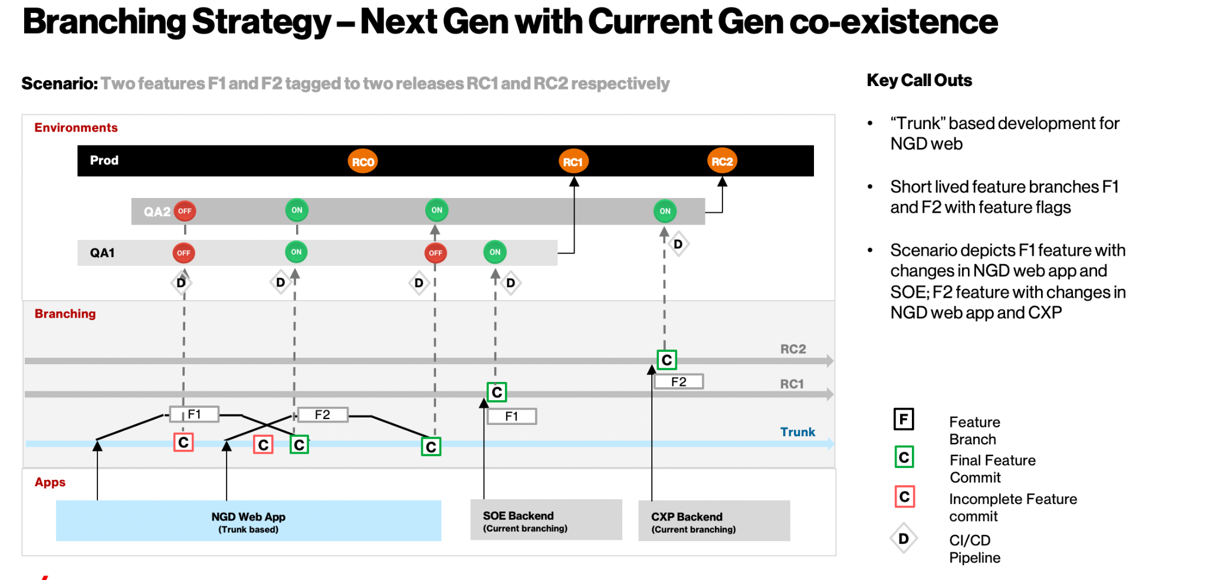

Slide 79
Branching Strategy
Next Gen development would follow “Trunk Based” Development for new repositories.
A source-control branching model, where developers collaborate on code in a single branch called ‘trunk’
Main Branch(Trunk)
ER
MR
ER
Short lived feature branches with toggle
Application | Branching Strategy
NGD WebApp (new SOE Front End) | NGD WebApp to follow trunk-based development along with feature flag to enable / disable features.
SOE Services | These apps / existing application layer will continue to use the current branching strategy (feature->develop->release-main) Any new changes for NGD would be implemented using feature flag Any “new” service layer repo to follow trunk-based development
CXP Aggregate
CXP Domain
PEGA/CJCM
AEM

Slide 80
Current Gen vs NGD Throttling

Slide 81

Current Gen and NGD Throttling
AEM Dispatcher
AWS-EKS
verizon.com
Cookie=CG
Throttle
Page Cache Expired? or No-Cache
Yes
SET Cookie
Request Origin based on URL and throttle
Verizon.com/smartphones
verizon.com
90%=home.html
10%=NGD-home.html
/smartphones
10%=/ngd/smartphones
90%=/us/smartphones
Cookie=NG
AEM Pages
NSA Pages
No
Throttle based on location
Setup Rules only for URL’s where new page is live on NGD
For URLS not configured, set cookie value to CG (CurrentGen)
Pega could have new journey for NGD
Pages
NGD WebApp
Home.html
/ngd/smartphones
NGD-Home.html
Current Gen WebApp
Cached Pages
/smartphones
Home
Home
SOE Services
Cache Page in CDN
Returns page based on throttle
PDP
PDP
Backend layers (SOE, CXP, PEGA ) to have feature flag-based implementation based on throttle cookie

Slide 82


Current Gen and NGD Throttling with Edg.io and EKS
VZ Yellow Zone
VZ Green Zone
Based on
Redirect_To Cookie persist the user to already throttled experience
Throttling
Verizon.com
/smartphones
Current Gen Web App
90 %
<eks-domain>/us/smartphones
Throttle based on location
Setup Rules only for URL’s where new page is live on NGD
NGD Web App
9 %
<eks-domain>/ngd/smartphones
OPEN IG / APIGEE
Edgio Cloud [AWS Lambda]
1 %
NGD Web App
SOE Services
<edgio-domain>/ngd/smartphones
Backend layers (SOE, CXP, PEGA ) to have feature flag-based implementation based on throttle cookie

Slide 83
NGD Blue Print Web App

Slide 84
Blueprint web app serves as a foundational “quick start app” for developers. The app lays the groundwork by implementing “core frameworks” & “reference implementations”
Web Core Framework
NGD Blueprint Reference Apps
Developer Benefits
Unit Testing
Error Handling
Logging
Tagging
3rd Party Integration
Rendering Patterns
Caching
State Management
Common Layout
Pre-Commit Hooks
App Config
Polymap
MFE 1: Developer “How to” Guide App
Reference app with live examples, sample code and documentation to “demonstrate core frameworks capabilities”
Ready to use core frameworks
Quick start templates
Sample code snippets
Live reference implementations
Faster Adoption
Framework usage documentation
Best practices
MFE 2: Browse App *
Scaled down version of GW/PDP to showcase SSR, SPA Transition and VDS Integration
MFE 3: Configurator App *
Scaled down version of Accessory interstitial page to demonstrate Transition between MFEs
* Light weight MFE examples to showcase MFE code structure, integration approach, rendering strategies and transition across the apps
Notes:
Can we quantify the benefits
Reuse as is vs implement for given use case

Slide 85
Overview | Developer “How to” Guide App
Architecture Tenants | Restricted Blas Radius| Error Handling Framework
Developers reference app with live examples and documentation for faster ramp-up.
What’s Included in reference app | Usage
Next.JS rendering patterns with examples Error Handling patterns with examples Caching and revalidate use cases in Next.JS State management use cases with examples Unit Testing examples Developer Guide Documentation | Refer documentation on framework usage Use implementation reference while working on Stories Developer can clone and run reference app locally Execute live examples with sample code
Reference App benefits:
Quick Start development of new pages with common layout and integrated core framework .
Core framework reference code with actual implementation – Faster adoption and time saving
Learn about framework components and how to implement them

Slide 86
Exception Handling

Slide 87


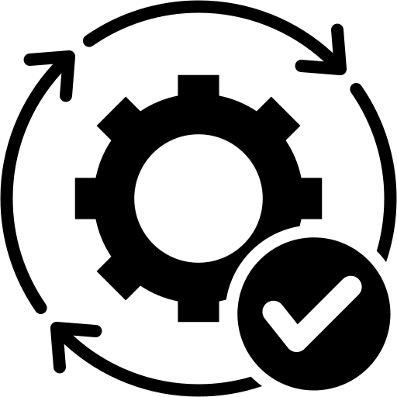
Overview | Error Framework and Logging
Architecture Tenants | Restricted Blast Radius| Error Handling Framework
Provide best digital experience to Verizon customers by designing for failure and graceful error handling
Build for Failure | Error Free Experience | Graceful Messaging
Inbuilt Retry mechanism Handles 4xx/5xx and business errors Handles both client and server-side errors Inbuilt timeout mechanism Automatic error logging for client and server errors | Intercept errors and show Fall Back experience Fallback Page Fallback Component Ability to configure different fallback experiences for different error codes | Relevant, Contextual Error Messaging Business Errors Authored via AEM
Framework benefits:
Global error handling framework which can be used across channels
Easy integration of fallback experience for error scenarios
Reference implementation for client and server error handling
Works for both Next.js and vanilla react applications
Developer API available for client and server-side logging

Slide 88
Blueprint Web App Status
Category | Task | What's Covered | Status | Tasks covered outside of Blueprint (during dev)
Core Framework and Developer “How to” Guide App | Unit Testing | Jest | Done | CI/CD Integration for code coverage on VZ env
 | Error Framework | Client and Server Exception Handling | Done | Actual implementation based on new design Error handling Enforcement
 | Logging | Client and Server-side logging | Done | Log consolidation and EKS Validation
 | Tagging | Tagging framework | Done | Implementing tagging based on NGD design ReadDL Implementation, EKS Validation
 | 3rd Party Integration | Launch.js integration | Done | Integration of 3rd party tool to the pages based on NGD design (chat, feedback etc)
 | Rendering Patterns | SSR, CSR | Done | Implementation based on NGD flow
 | Caching | Next.js caching and Invalidation | Done | Implementation based on NGD flow
 | State Management | TanStack | Done | Implementation based on NGD flow
 | Common Layouts | Common layout with header, footer | Done
 | Pre-Commit Hooks | JS and CSS linting, format, running test case and coverage, formatting | Done | CI Integration on VZ
 | App Config | Reference Implementation for Web | Done | Implementation based on NGD requirements
 | Poly Map | Framework Integration | Done | Implementation based on NGD requirements
Build and Deployment | Edg.io POC | Reference App Deployed on MFE | Done | EA, Security & SRE Approval , Ticket Submitted
 | EKS Setup | Build Scripts | Done | CI/CD Setup for Browse MFE and Configurator MFE
 | Common Repo | Common libraries | Done | Extraction of common code to a separate repo
Browse and Configurator MFE | Browse and Configurator MFE | Scaled down version GW, PDP and Accessory pages | Done | Actual Implementation of the pages based on NGD Designs Existing API Optimization

Slide 89
Quality Engineering

Slide 90





Quality Engineering Focus Areas
QE Strategy and Governance
Product Management In A “Digital Era”
TIME
SCOPE
COST
QUALITY ENGINEERING
SPEED
QUALITY
VALUE
Measurement
Tools
Speed
How do we go as fast as possible, from an idea to production?
Quality
How do we make sure all feedback loops are accounted for, like code reviews, customer feedback, production monitoring and the like?
Value
How do we focus on value rather than costs?
Talent

Slide 91





QE Focus Areas & Approach
Product Mindset
Automation
Browser & Devices Testing
NFRs
Business Outcome
Product mindset for functional coverage & traceability in real time JIRA view
Traceability of requirement vs. test scripts
40% Progression during sprint
70 % Regression coverage for N-1 sprint scope
BDD approach for more business-centric tests
Automated 100 % Sanity suite integrated with CI/CD
Browser & Device Compatibility Testing
Android & iOS platform specific validation
Accessibility test using NVDA tool
Standard Security scan through GSO-STAR team
Performance test for benchmark of application through PSST team
Time to market readiness check if any critical fix on prod
Handshake between PO & Business for outcome

Slide 92




Automation Coverage
Functional
Mobile
User Interface
Services
Sanity
Regression Suites
Progression
End to End testing
Native and hybrid apps (IoS and Android)
Parallel execution on real devices
Integration with CI tools
Integration with Cloud
Customized html reports with email notifications
Validation of UI elements like Fonts ,Pixels etc.
Functionality like links, buttons tabbing etc.
Accessibility testing
Web Services
Micro Services
REST/SOAP/JSON & XML validation

Slide 93
Test Automation using TestX and Cucumber BDD

Slide 94
TestX Accelerator
PS InnerSource ecosystem developed by PS engineers to accelerate solutions for PS clients; where TestX gives you the best-in-class Quality Engineering frameworks to accelerate your End-to-End Test deliverables and bring radical new efficiencies across the test lifecycle.
Key TestX Accelerators:
Microservice Testing (ResrAassured)
Load Testing (Gatling)
Web Testing (WDIO)
Accessibility Testing (Axecore)
E2E Testing
Key Benefits :
BDD Based framework : Business-friendly test scenarios
Cucumber reporting Integrated : For easy test execution reporting
Test data management : Test data files are maintained in framework independent json files for easy change and maintenance
Open source : No cost and no additional license required.
DevOps Integration : Jenkin integration and build verification.
Device and OS support : It supports all device and OS combination, Real and emulator execution support
Cloud execution : Simple and single command integration with Saucelabs or Sauce labs other cloud service providers to access 100s of devices and browsers
Note: All the accelerators are ready to use just install dependencies and start writing new tests.

Slide 95
TestX – Accelerator : Key Features
Functional & API Testing
Parallel
Execution
Headless
Execution
DevOps
Integration
Cloud execution
Scalable
&
Lightweight
Accessibility Testing
(Axe-Core)
Device & OS Support
Reports
(Allure, Cumber
Console)
Lighthouse Integration

Slide 96


Behavior Driven Development [BDD] with Cucumber & TestX
Cucumber uses Gherkin language to define test cases in plain English
Given – When – Then Approach | Example Behavior Definition
Given: Some given context | Given: I am on Smartphones Page
When: Some action is performed | When: User clicks Product Tile
Then: Expected outcome | Then: User is navigated to product detail page
Product/ UAT / QA / Domain Expert
Define Behavior
Run and Pass
Step Definition
Given(/I open the Smartphones page", function () { cy.visit(“https://www.verizon.com/smartphones/”) }); When(/^User clicks Product Tile $/, function (state) { // Write test script here that turns the phrase above into concrete actions }); Then(/^User is navigated to product detail page ”$/, function (state) { // Write the test script here that turns the phrase above into concrete actions });
Write code to make step pass
Run and fail
Developer

Slide 97
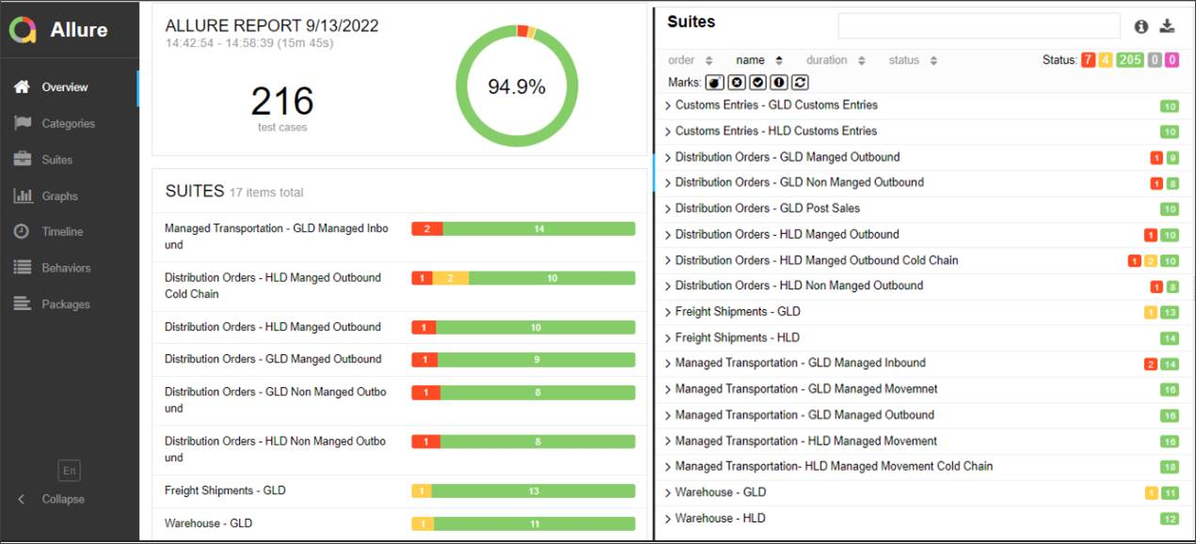
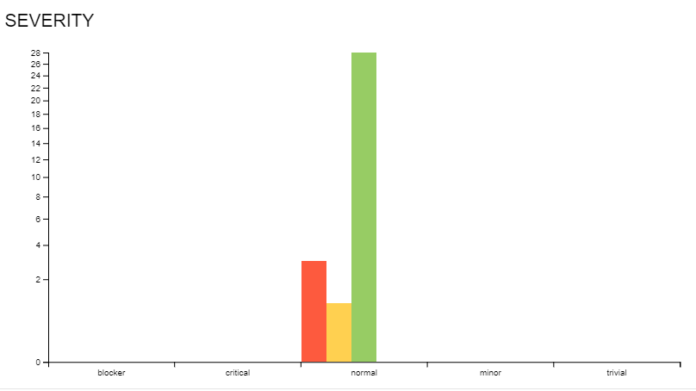
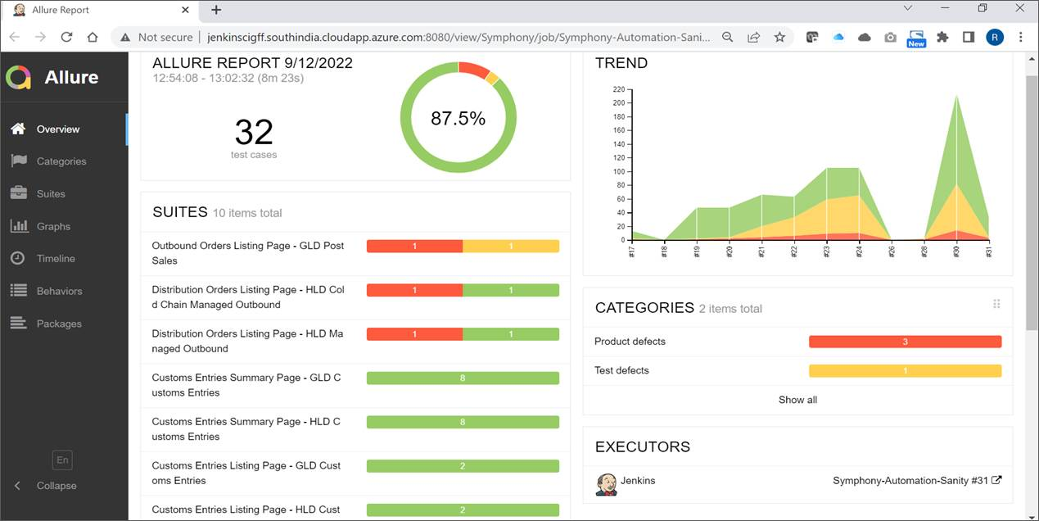
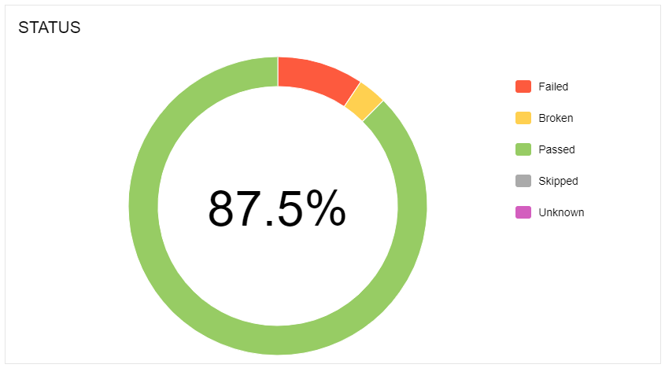
Sample TestX Accelerator Report

Slide 98
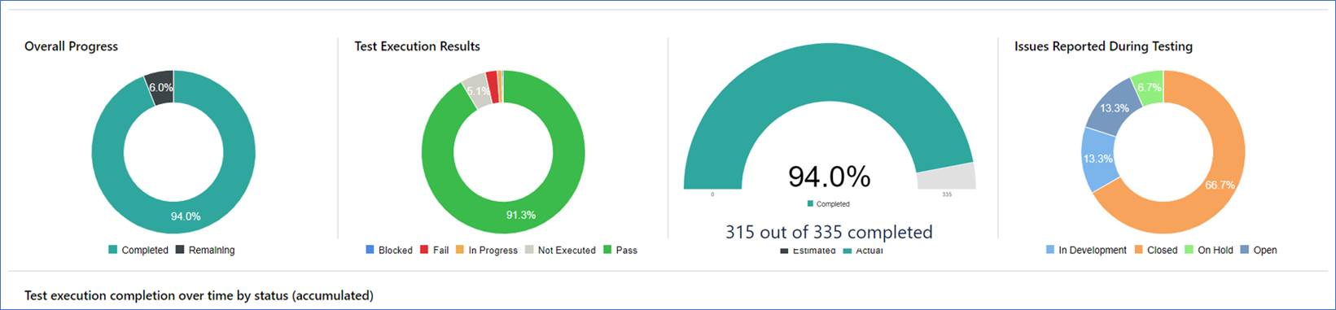
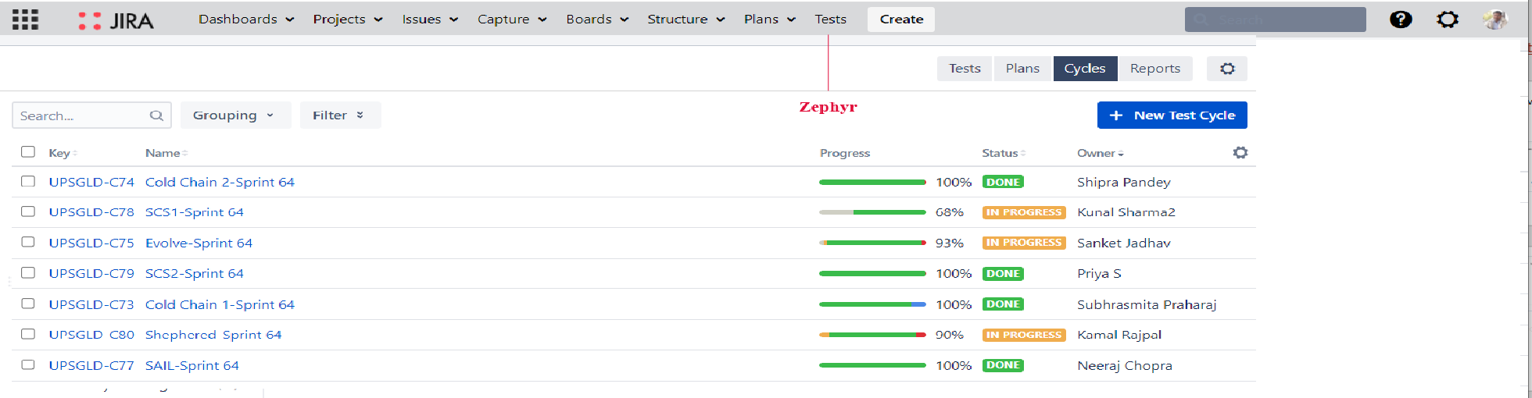
Zephyr Test Management Tool – Integrated with JIRA | Sample Report

Slide 99
Summary of Architecture Foundation
Category | Key Decision | Outcome | Status
Core Architecture Tenets | Defined architecture tenets and guiding principles | Aligned Digital Architects | Done
“Learn” Pages Architecture | AEM Pages to continue with current state architecture | Aligned approach with EA , AEM Platform | Done
NSA Pages Web Framework | Next.js chosen as the web framework | Aligned with EA and Digital Architects | Done
Rendering Strategies | Next.js Framework can support SSR, CSR ,Hybrid and Static site generation | Aligned with EA and Digital Architects | Done
MFE Approach | Poly repo approach using , Multi Zone | Aligned with Digital Architects. | Done
Web Architecture Alignment with Assisted | Reviewed NGD Architecture with Assisted team . Assisted would need to migrate to Next.js to leverage NGD Next.js components and framework benefits. NGD common react components/framework libs can be reused though w/o migrating to Next.js | 5/2 - EA Shared recommendation with Assisted | Done
Shift Left / Performance Strategy / Tools | Tools and shift lefts tasks defined | Aligned with Digital Architects and SRE | Done
Branching & Env Strategy | NGD Web app to use trunk-based development. Existing Backend SEO, CXP etc to remain in release branching strategy. NGD to use existing ER environment | Aligned with Digital Architects and SRE | Done
Environment [PERF] | Discussed the feasibility of having a dedicated environment with SRE and PERF Team NGD will follow the current Load test process in SIT env and Prod with additional shift left performance checks. Dedicated env not feasible currently, this would need incur additional maintenance effort and cost | Aligned with Digital Architects and SRE | Done
QE Automation | Discussed automation framework options. NGD to continue using VZ Tapsium framework | Aligned with VZ QE Automation team | Done
Native App Strategy | Discussed with MVA Team, Digital Architects , EA and aligned to use Webview for BIC Buy Flow | Aligned with EA, Digital and MVA Architects | Done
Notes:
Started a lean team last week, with Kick off and onboarding and access requests…
Would drive to integrate copilot/GenAI capabilities during SDLC for core development to pull off the productivity levers…keeping in mind the efforts under Turing from governance standpoint…
Also, would like to bring over the efficiencies by plugging in the framework/accelerators from our in house PS innersource…specially around QE automation, testing and UI frameworks to avoid writing boilerplate code.

Slide 100
Q&A

Slide 101
Key Advantages of App Router
App router is the Next.js default option. The legacy Pages router in Next.js will no longer receive updates, so to continue to receive meaningful framework updates, we need to use App Router.
The App router is the only production stable framework providing support for React Server Components. We can’t use them in production today without Next.js.
With RSC, App Router brings the ability to chose where React component code is rendered, which is one of only a few ways to reduce JavaScript execution time on the client.
With App router server rendering, we have a way to lower bundle size on components that can be rendered server side.
App Router provides many updates to the file-based router and new features which will improve our code organization and management.

Slide 102
Addtl. Details on File Based Router updates
The Next.js App Router brings many improvements to the File-based router implementation:
Shared Layouts: App router solves a fundamental issue of the Next.Js pages router, which was how to distribute layout across routes.
Parallel routes / Intercepting routes: Parallel Routes allows you to simultaneously or conditionally render one or more pages within the same layout. They are useful for highly dynamic sections of an app, such as dashboards and feeds on social sites.
Route groups: Route groups enables improved code organization within the router folder structure.
Loading routes: Ability to show instant loading reaction while route segments are rendered.
Error routes: Gracefully handle unexpected runtime errors within nested routes.

